Slide 1
Super store data analysis
Project Overview
This project involves an in-depth analysis of the Superstore US dataset to uncover key insights that can drive business decisions.
The dataset includes various attributes related to sales, customers, products, and regions. The primary goal was to
answer 17 key business questions through detailed Exploratory Data Analysis (EDA), utilizing Python's Pandas for data manipulation,
and Seaborn and Matplotlib for data visualization.

Slide 2
Tools and Libraries Used
Python: The programming language used for analysis.
Pandas: Utilized for data manipulation and analysis.
Seaborn: Used for creating informative and attractive statistical graphics.
Matplotlib: Employed for generating plots and charts to visualize data.

Slide 3
Analysis Performed
The following 16 key questions were addressed using EDA:

Slide 4
1 Top 10 Customers: Identified the top 10 customers based on total sales.
2 No. 1 Customer and Their Orders: Analyzed the highest-spending customer and the products they ordered.
3 Most Profitable Category: Determined which product category generated the most profit.
4 Most Selling Product Sub-Category: Identified the sub-categories with the highest sales volume.
5 Most Selling Products: Analyzed which individual products are sold the most.
6 Category Sales by State: Explored which categories sell the most in each state.
7 Best Sales Month: Identified the month with the highest sales across the dataset.
8 Least Sales Month: Determined the month with the lowest sales.
9 State with Most Profit: Analyzed which state generated the highest profit.
10 State with Least Profit: Identified the state with the lowest profit.
11 Sales Values by Category and Sub-Category: Calculated total sales values for each category and sub-category.
12 Most Profitable Customer Segments: Analyzed which customer segments are the most profitable.
13 Most Profitable City in the Most Profitable State: Explored which city within the most profitable state generated the highest profit.
14 Least Profitable City in the Least Profitable State: Identified the least profitable city in the least profitable state.
15 Order Count and Profit by Region: Analyzed the number of orders and profit in each region.
16 Order Count and Profit by Priority: Explored how order priority affects the number of orders and profitability.

Slide 5
Key Insights
• Top Customers: Identified key customers who significantly contribute to the revenue.
• Product Performance: Provided insights into which products and categories drive sales and profit.
• Regional Analysis: Highlighted the states and cities with the highest and lowest performance, aiding in targeted strategies.
• Seasonal Trends: Discovered the best and worst performing months, which can help in inventory and sales planning.
• Customer Segmentation: Segmented customers based on profitability to better understand customer behavior and target marketing efforts.
• Order Prioritization: Explored the impact of order priority on sales, revealing which priorities result in higher profits.
• Shipping Methods: Analyzed the effectiveness of different shipping methods, offering insights into logistics efficiency.

Slide 6
Data Exploration
Shape of Data
To see all 25 columns in Data Frame
pd.options.display.max_columns = None
ss.head(5)
print("No Rows :" , ss.shape[0])
print('No Colums :' ,ss.shape[1])
>>>
No Rows : 1952
No Colums : 25

Slide 7
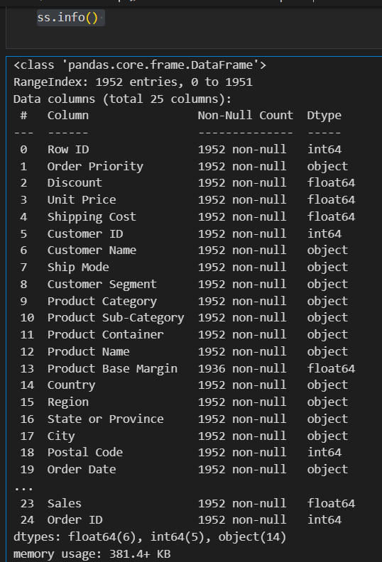
All information about data (dtypes , no of columns , no of rows etc)
ss.info()
>>>

Slide 8
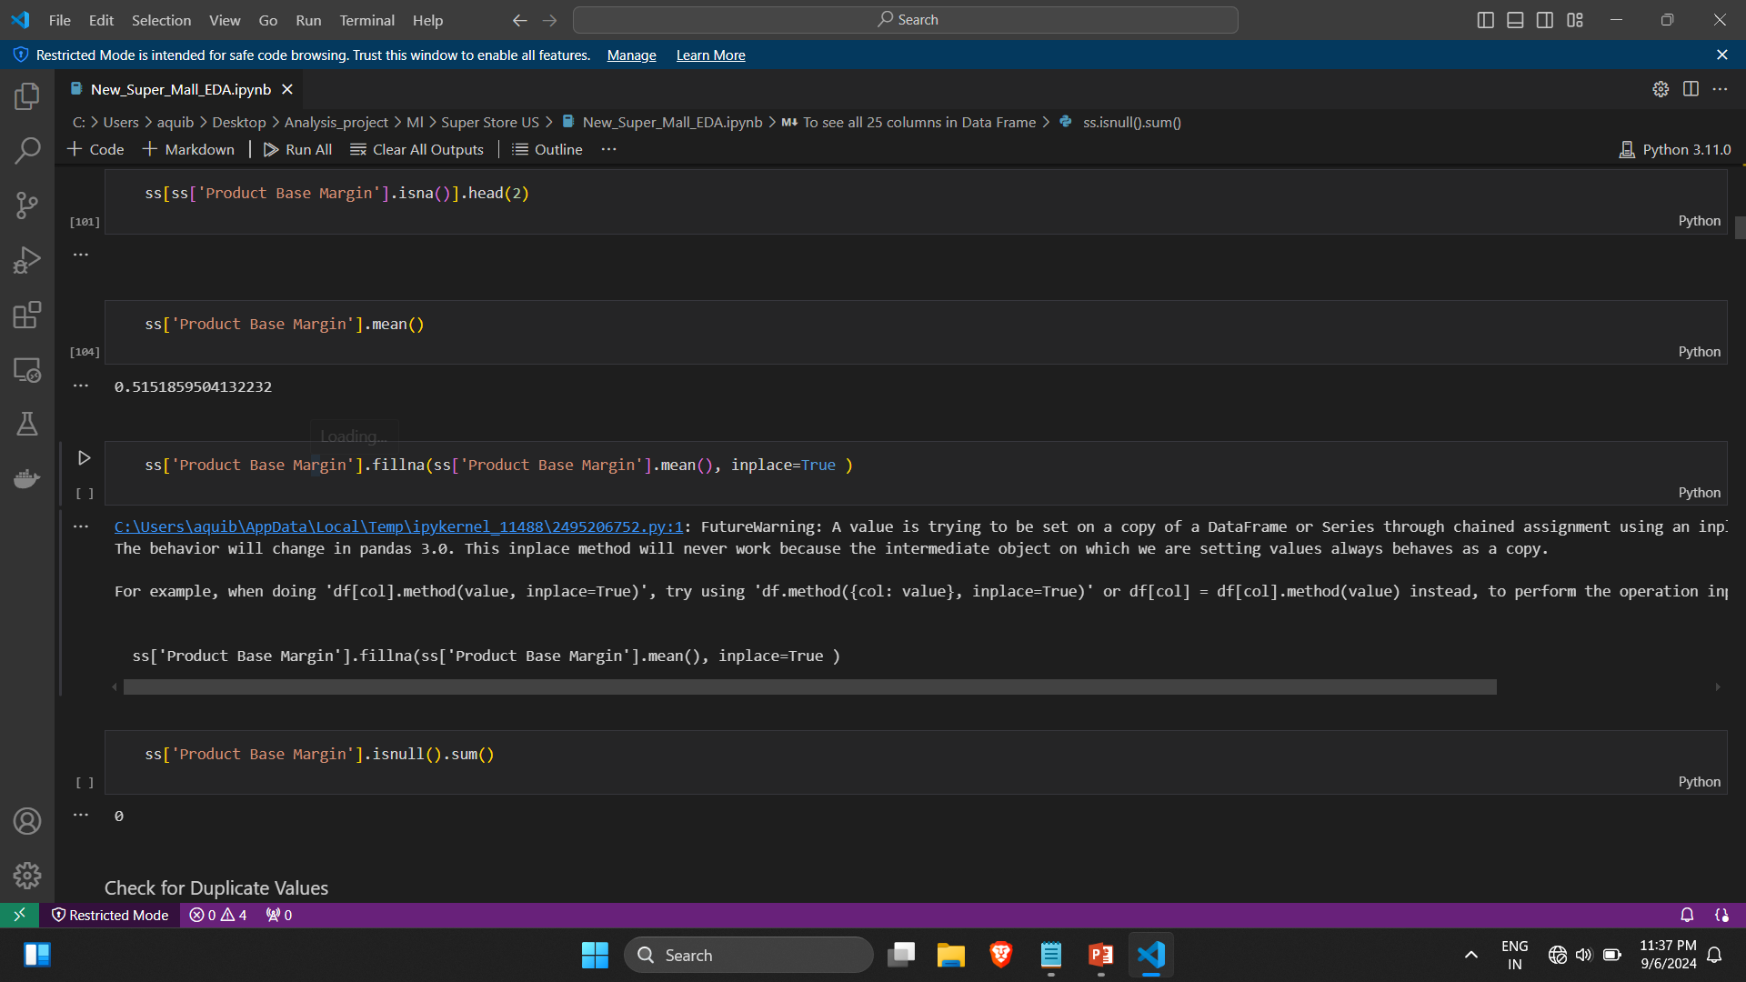
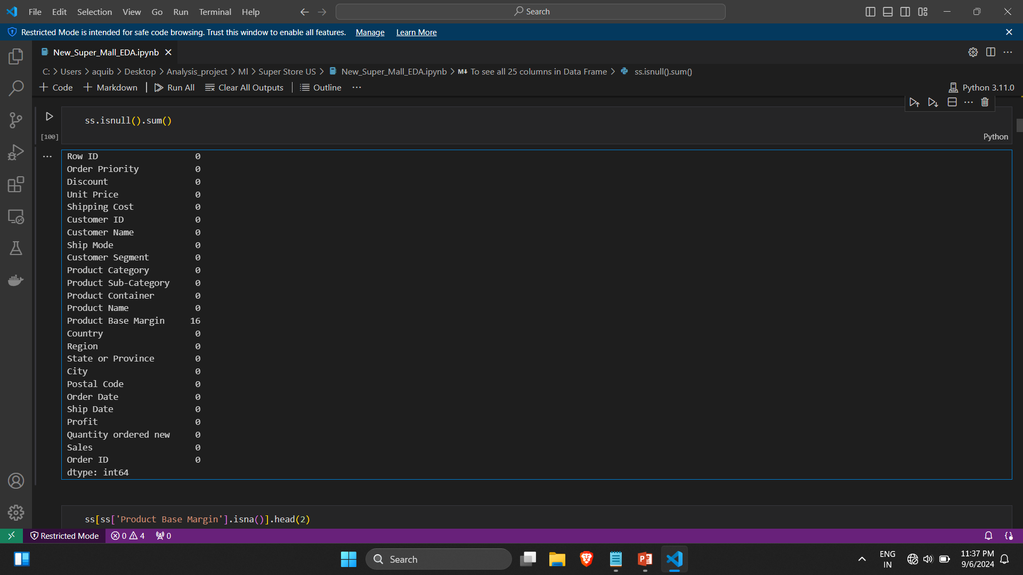
Cheack for Nulls Values
ss.isnull().sum()

Slide 9
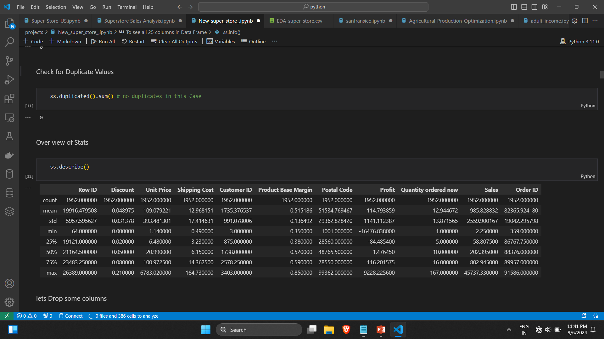

Slide 10
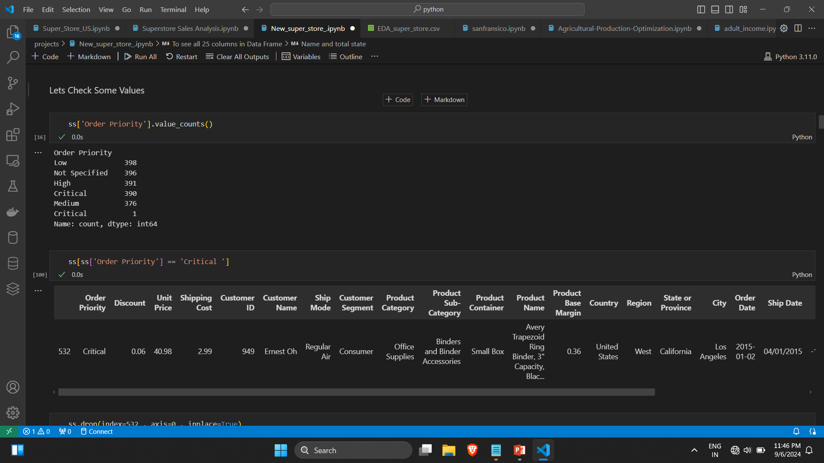
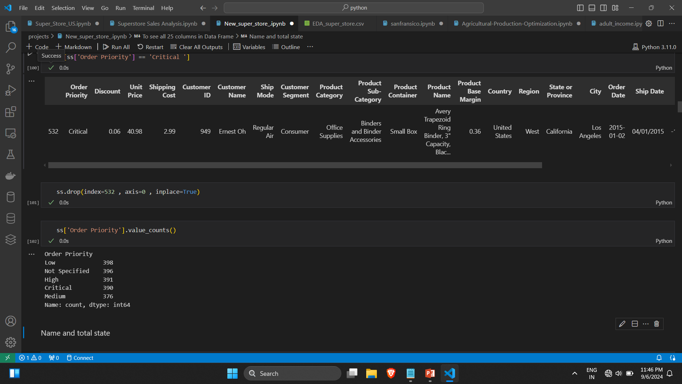

Slide 11
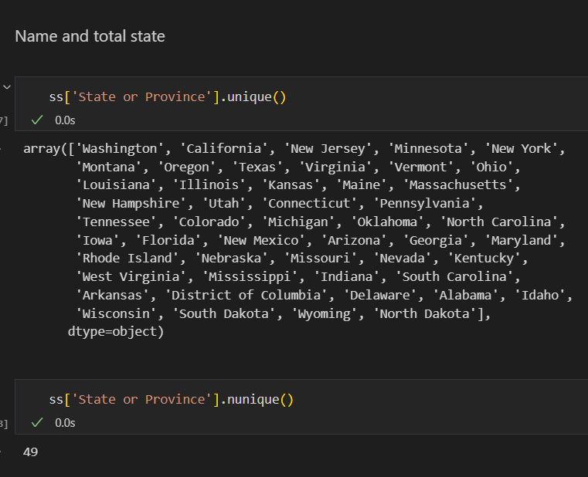

Slide 12
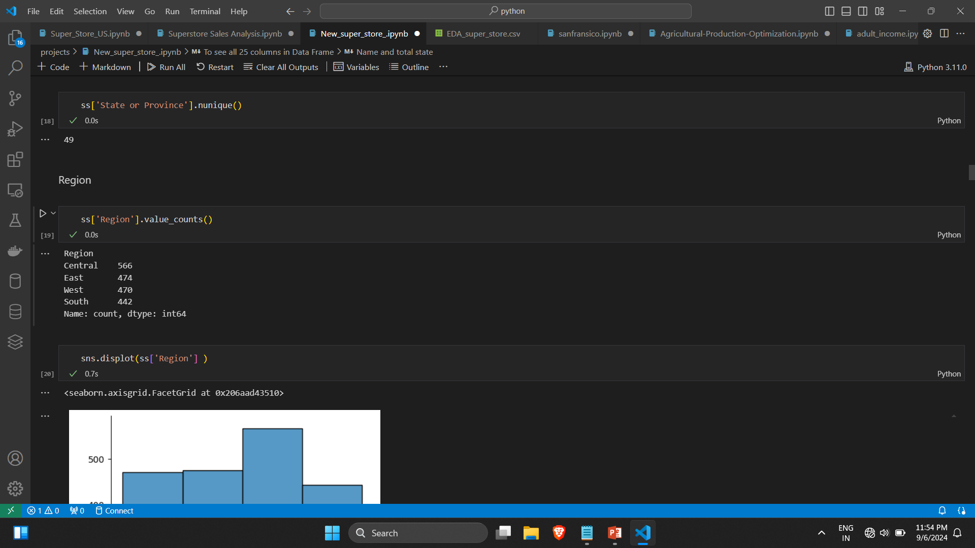
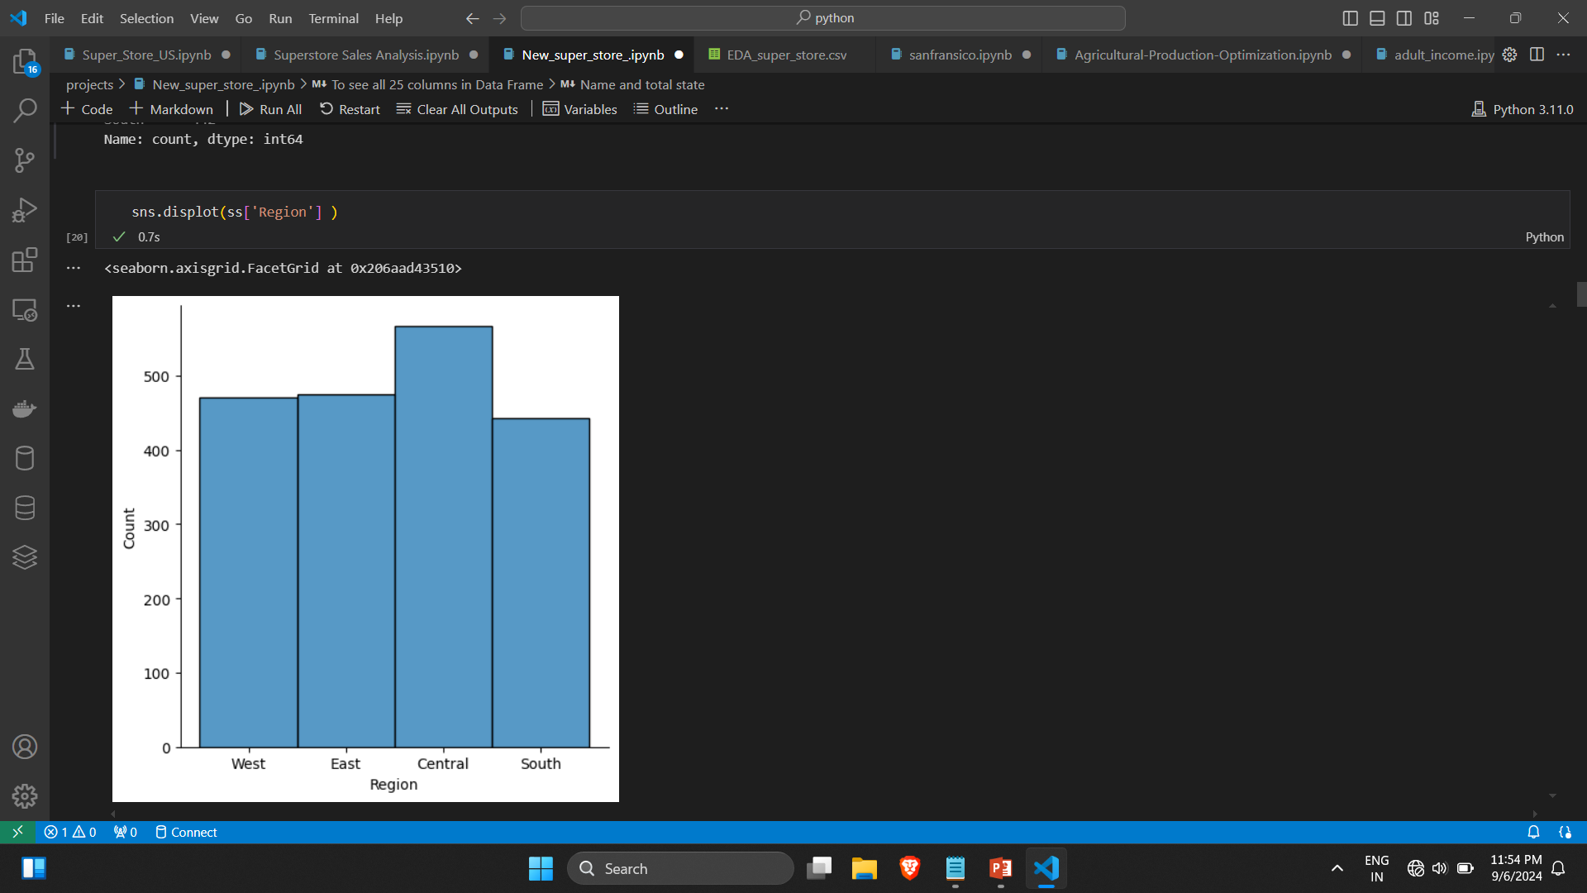

Slide 13
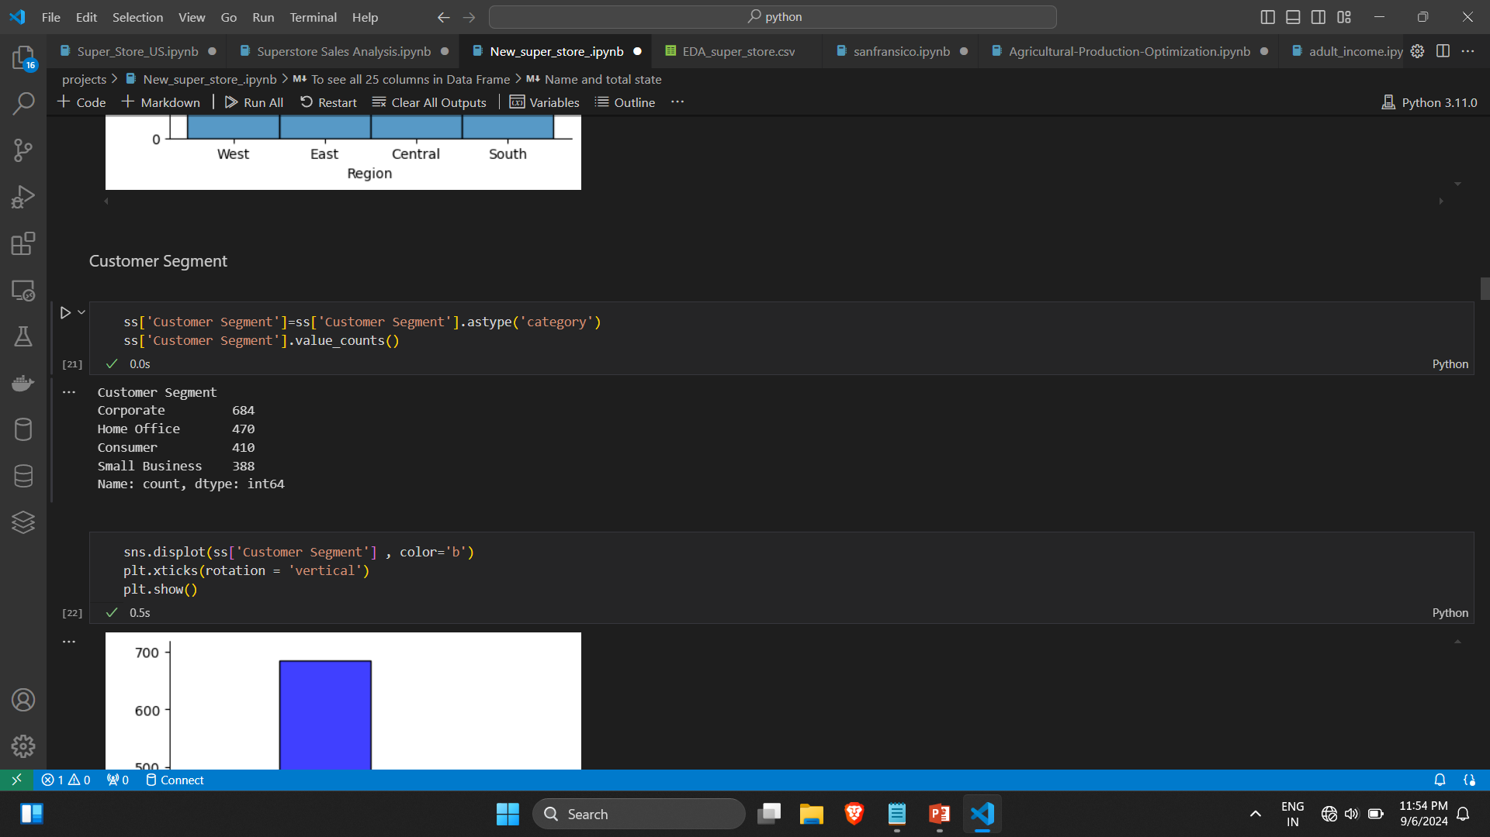
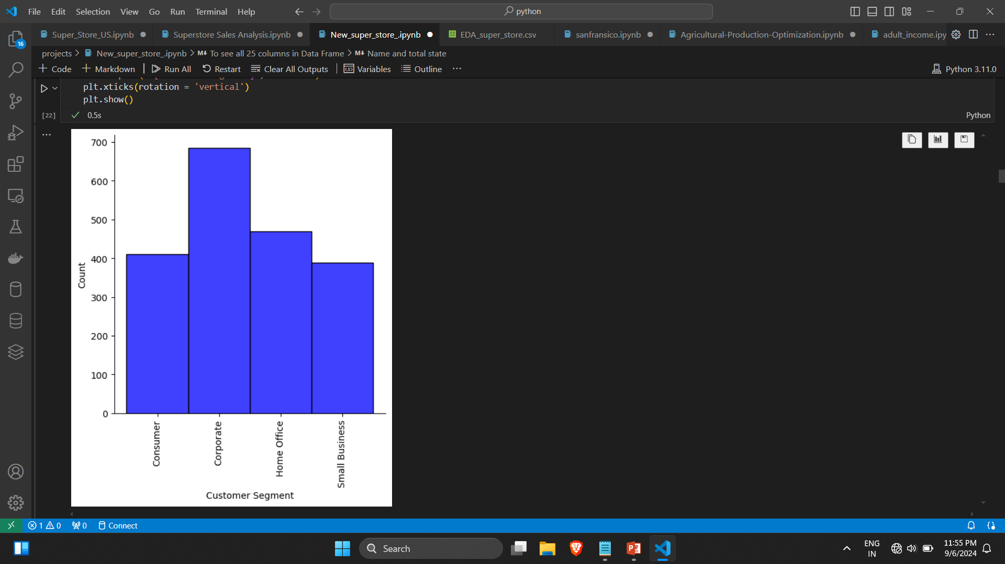

Slide 14
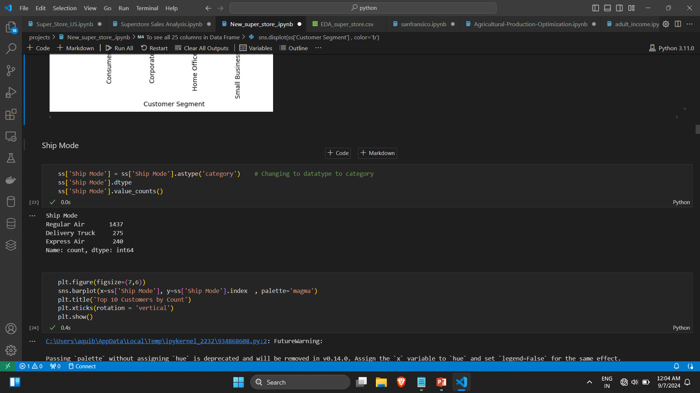

Slide 15
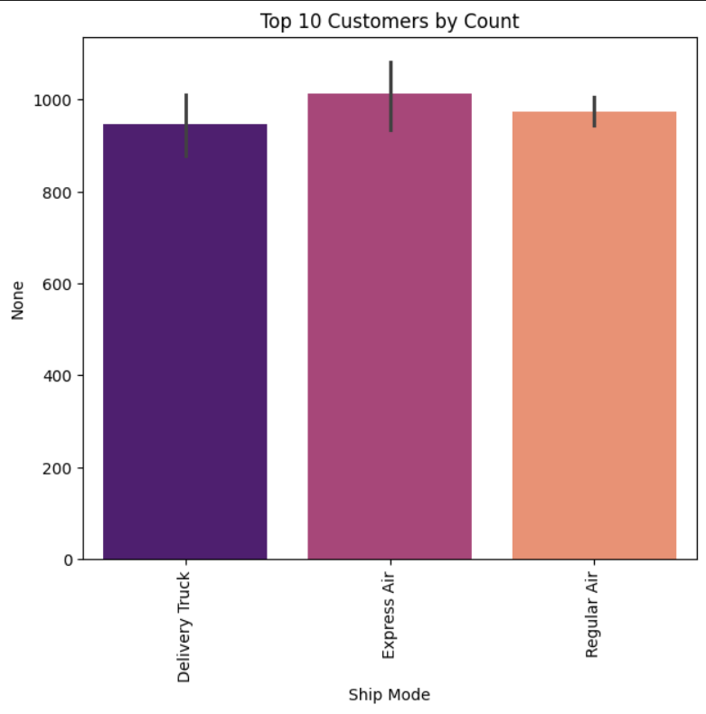

Slide 16
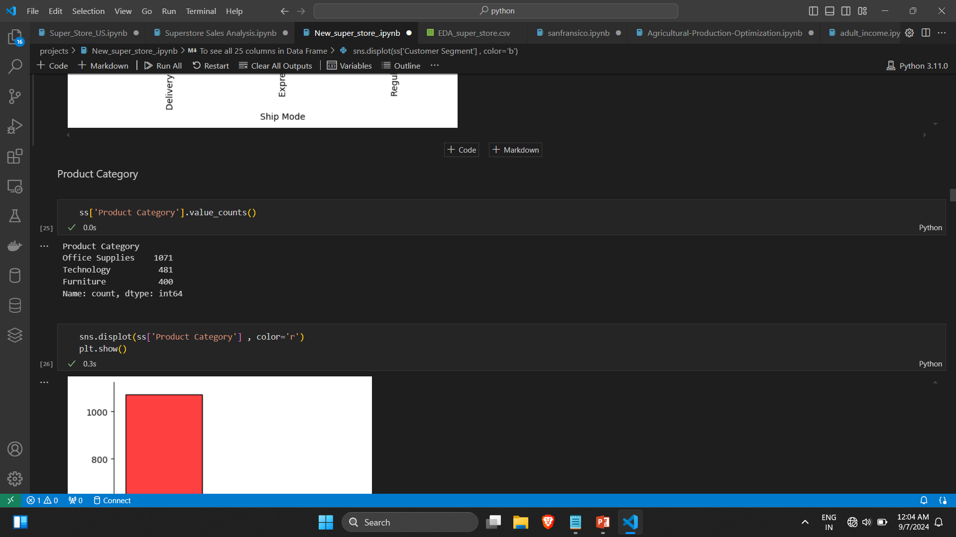
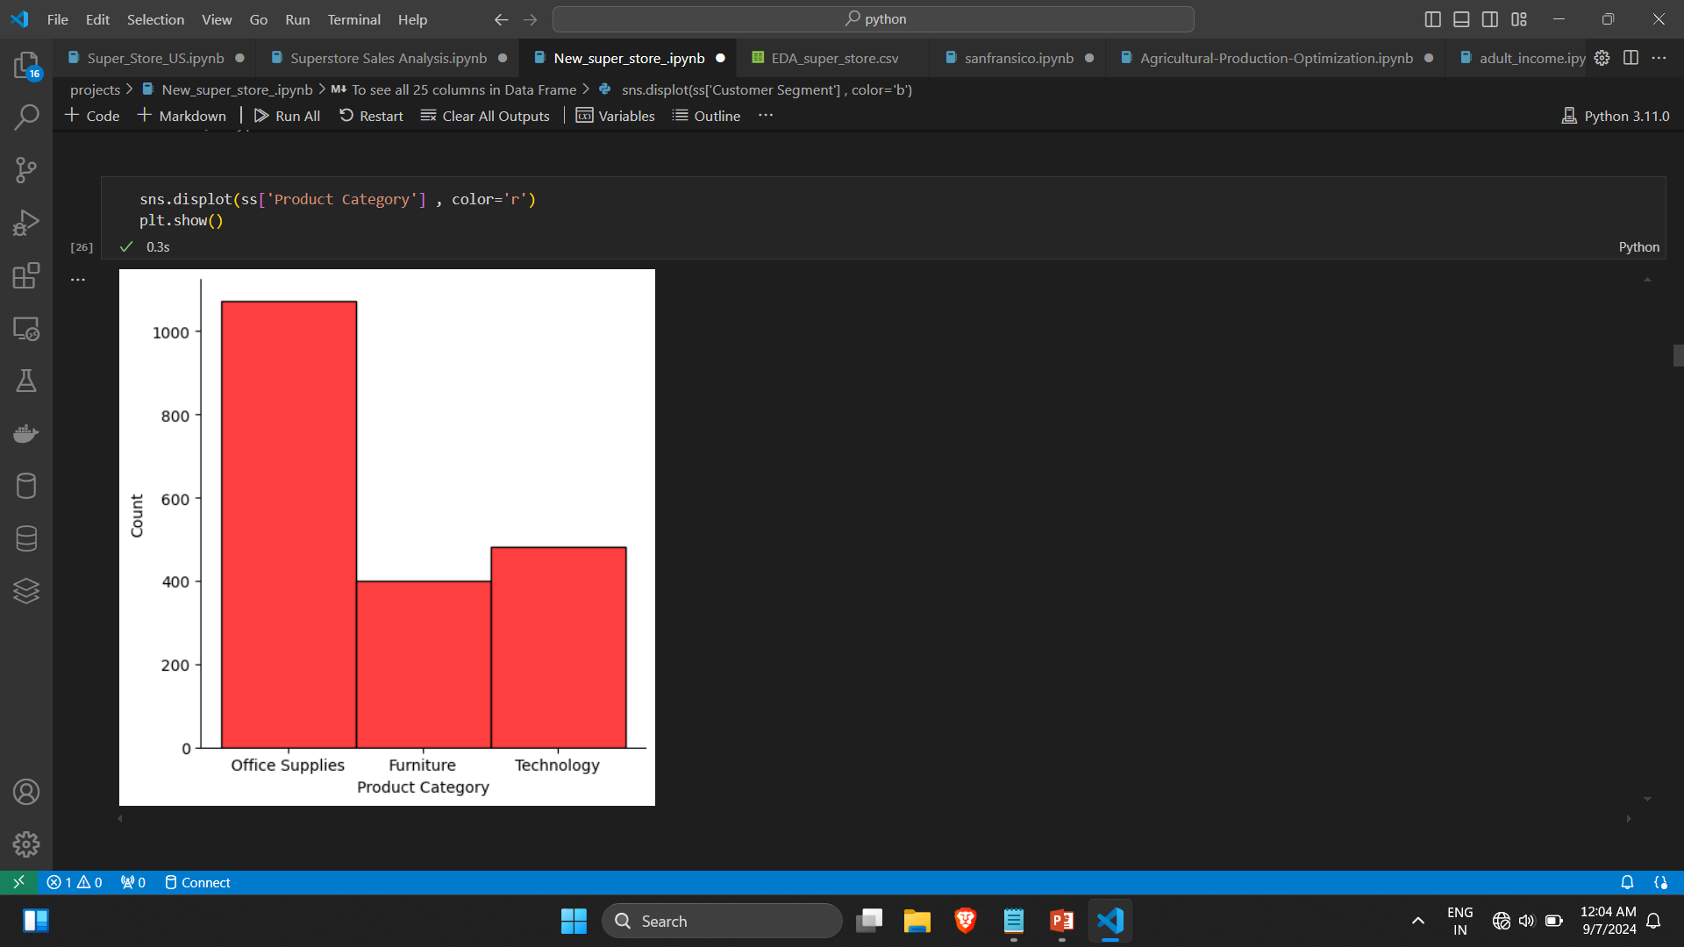

Slide 17
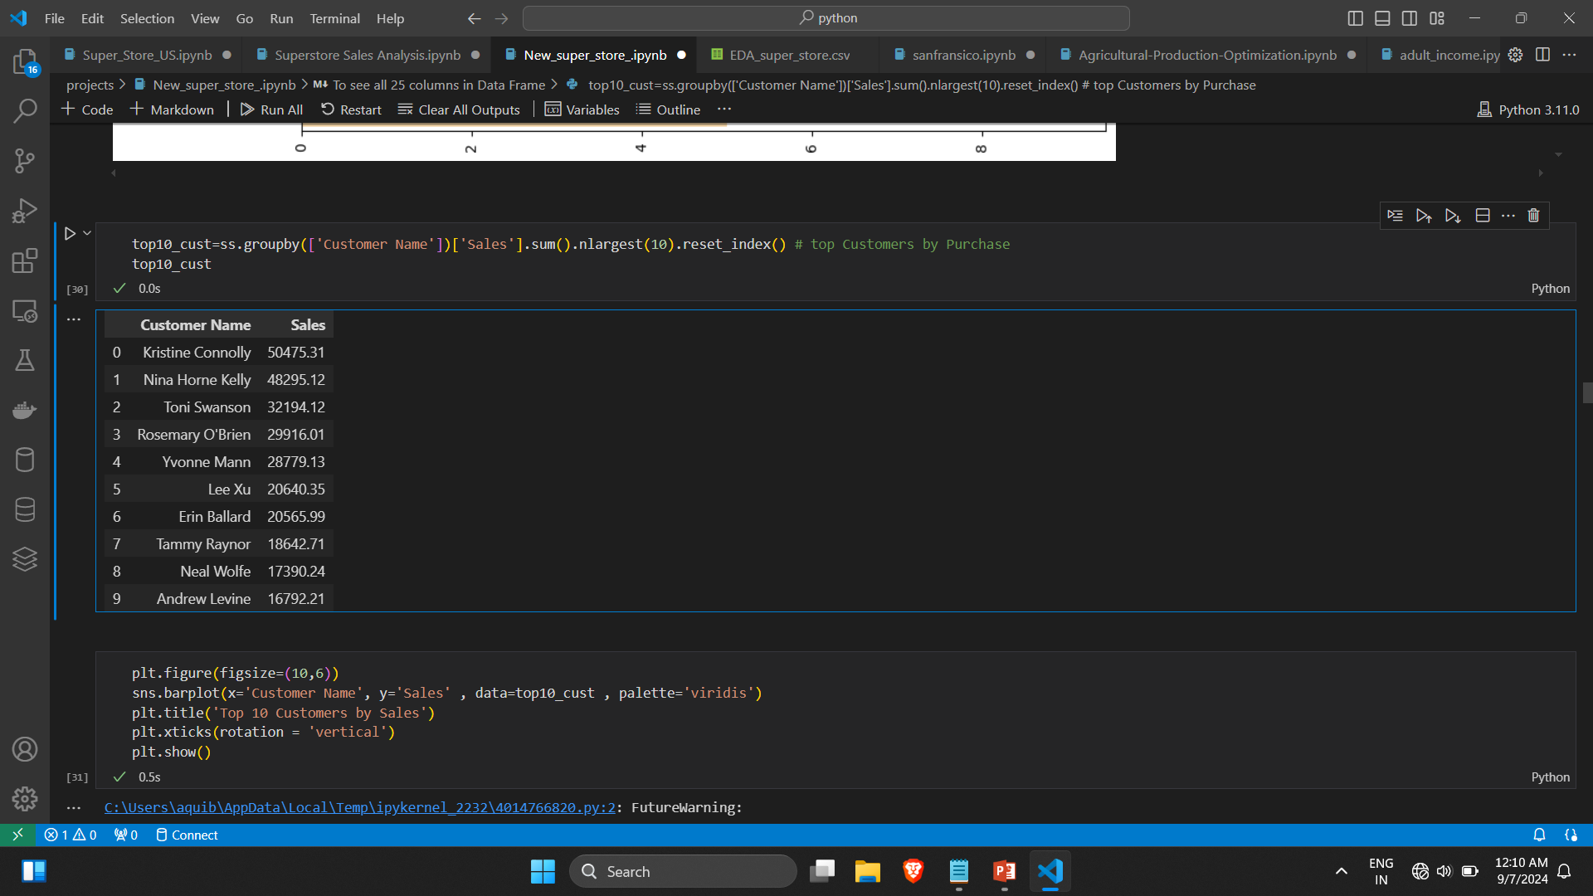
Q 1 Identified the top 10 customers based on total sales.

Slide 18
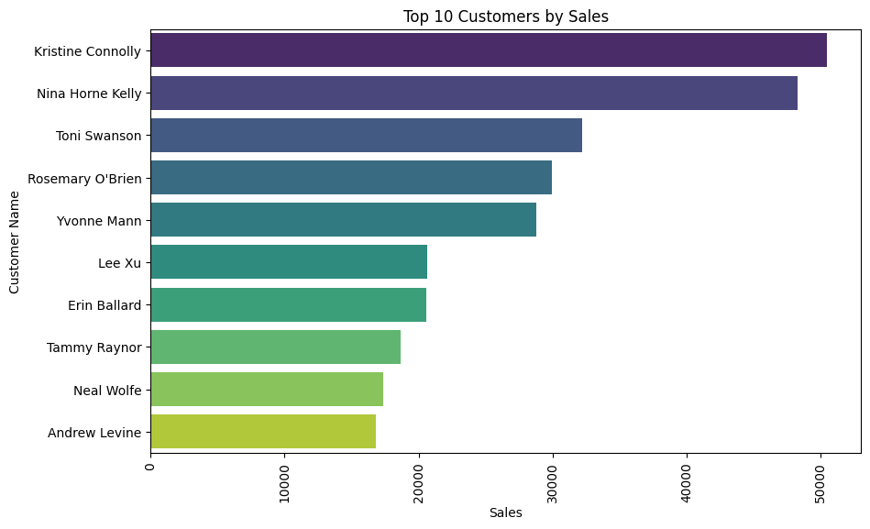

Slide 19
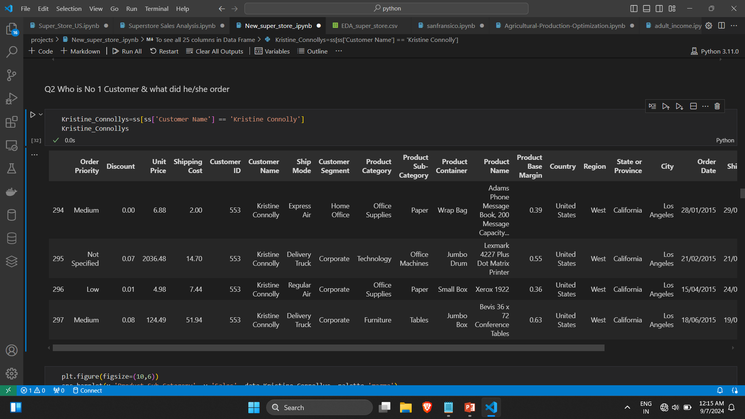
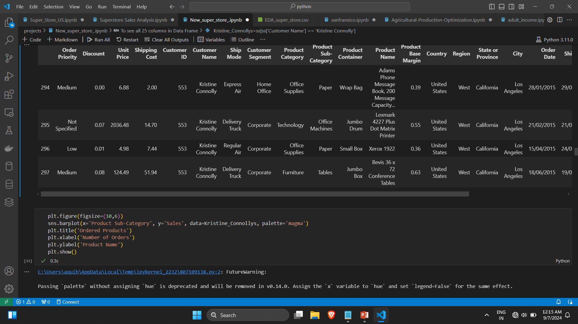
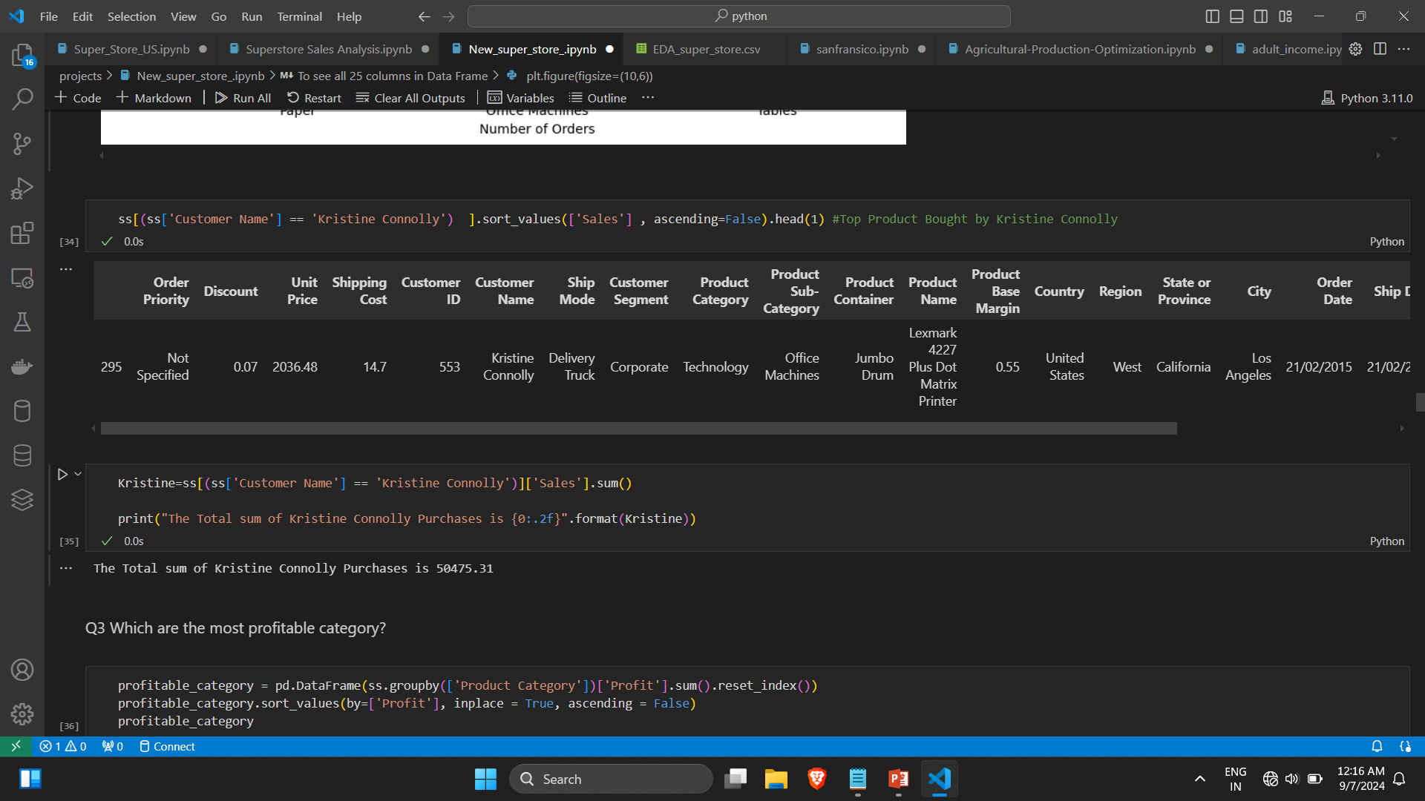
Q2 Analyzed the highest-spending customer and the products they ordered.

Slide 20
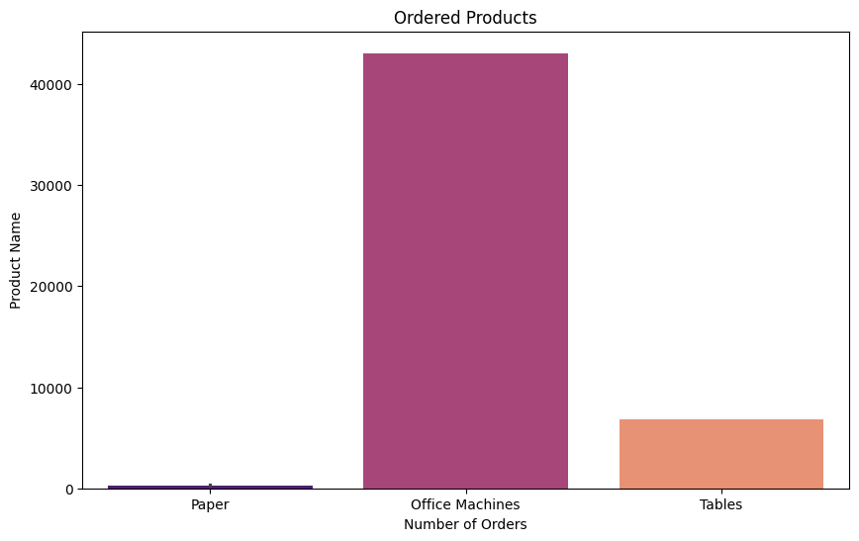

Slide 21
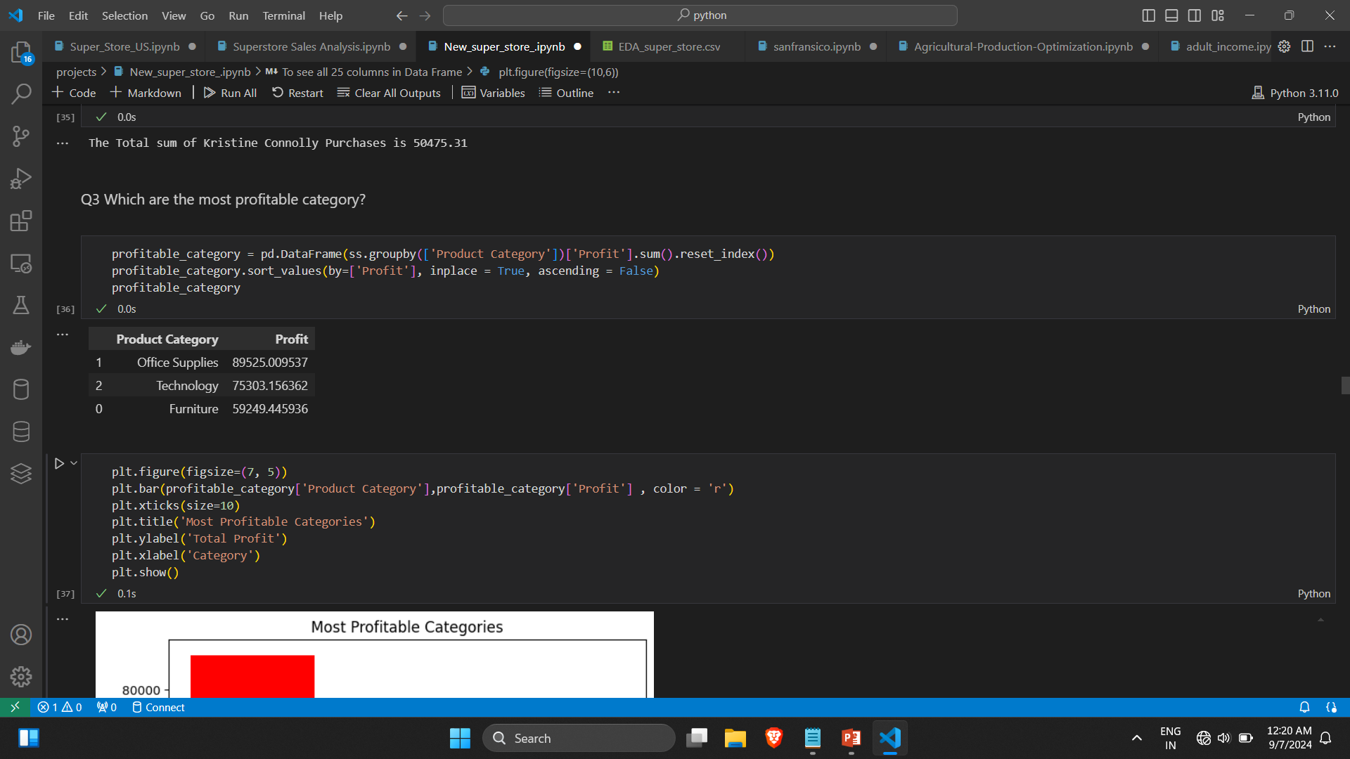
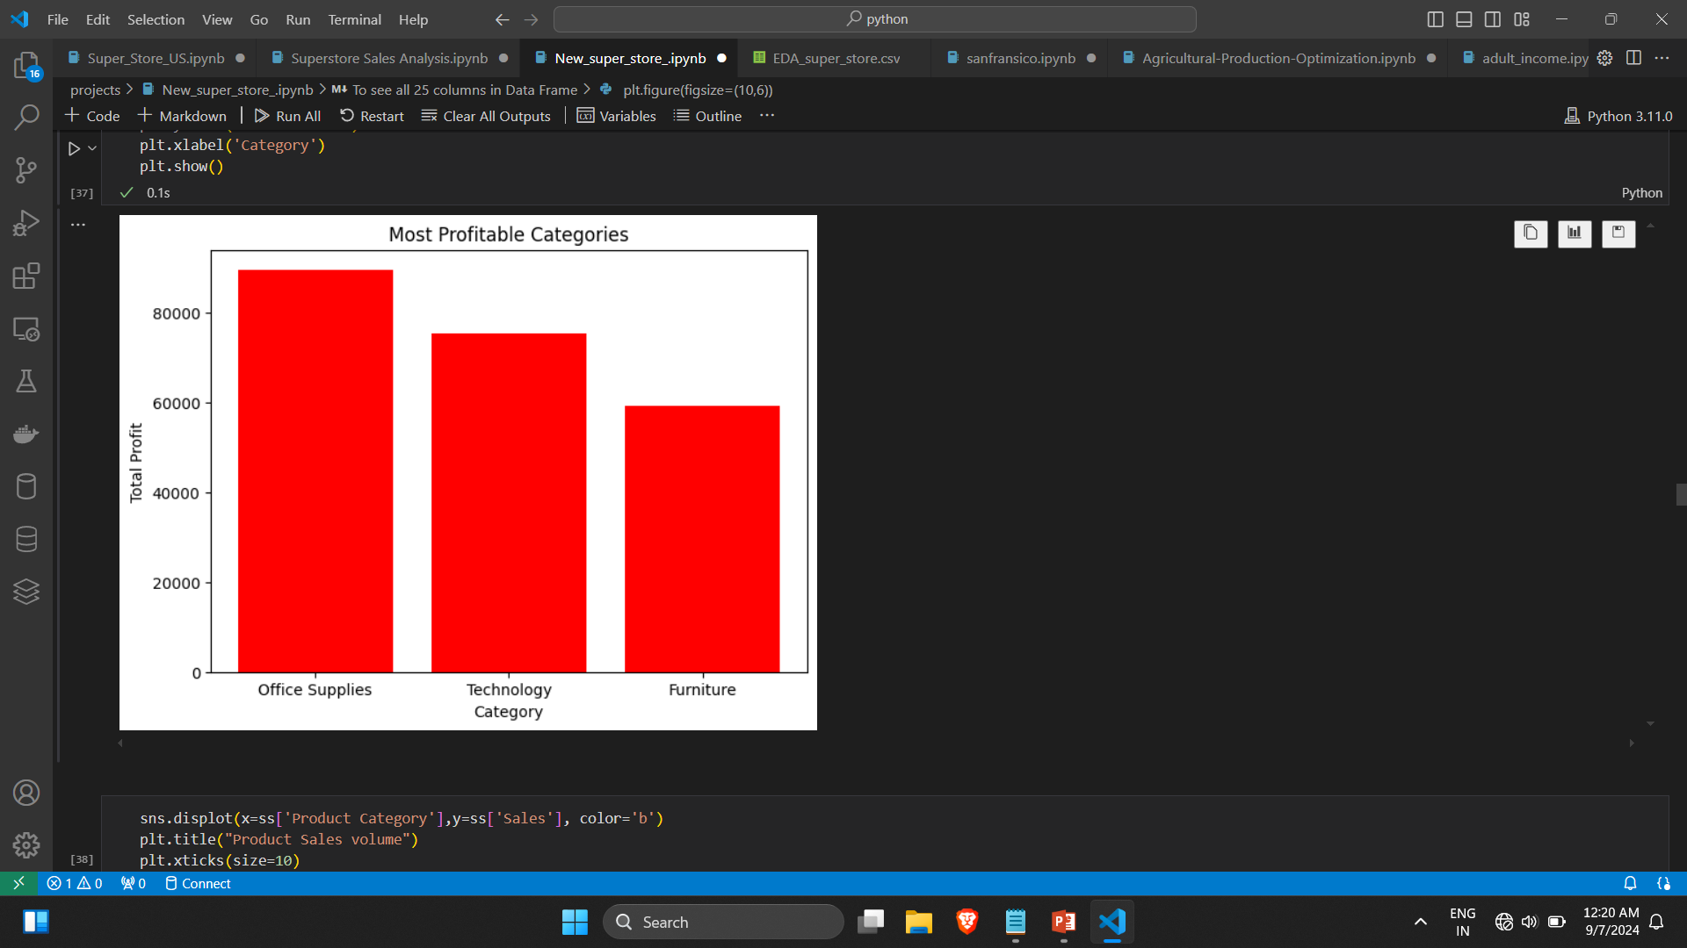
Q3 Determined which product category generated the most profit.

Slide 22
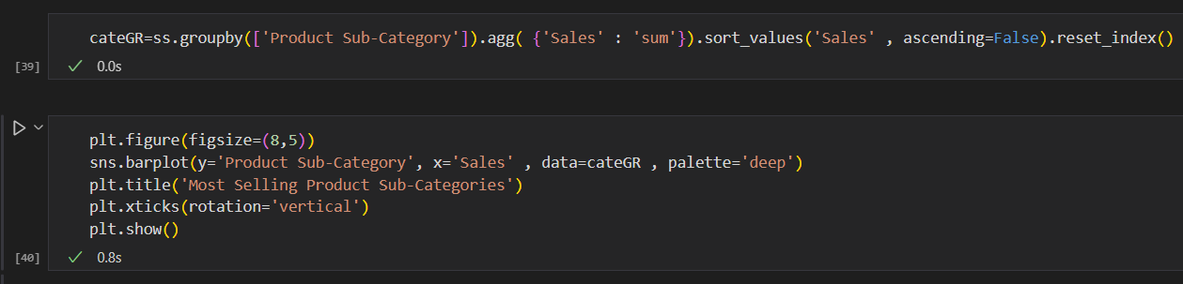
Q 4 Most Selling Product Sub-Category: Identified the sub-categories with the highest sales volume.

Slide 23
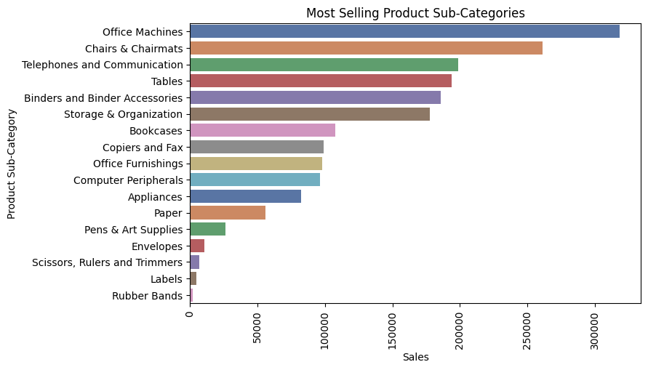

Slide 24
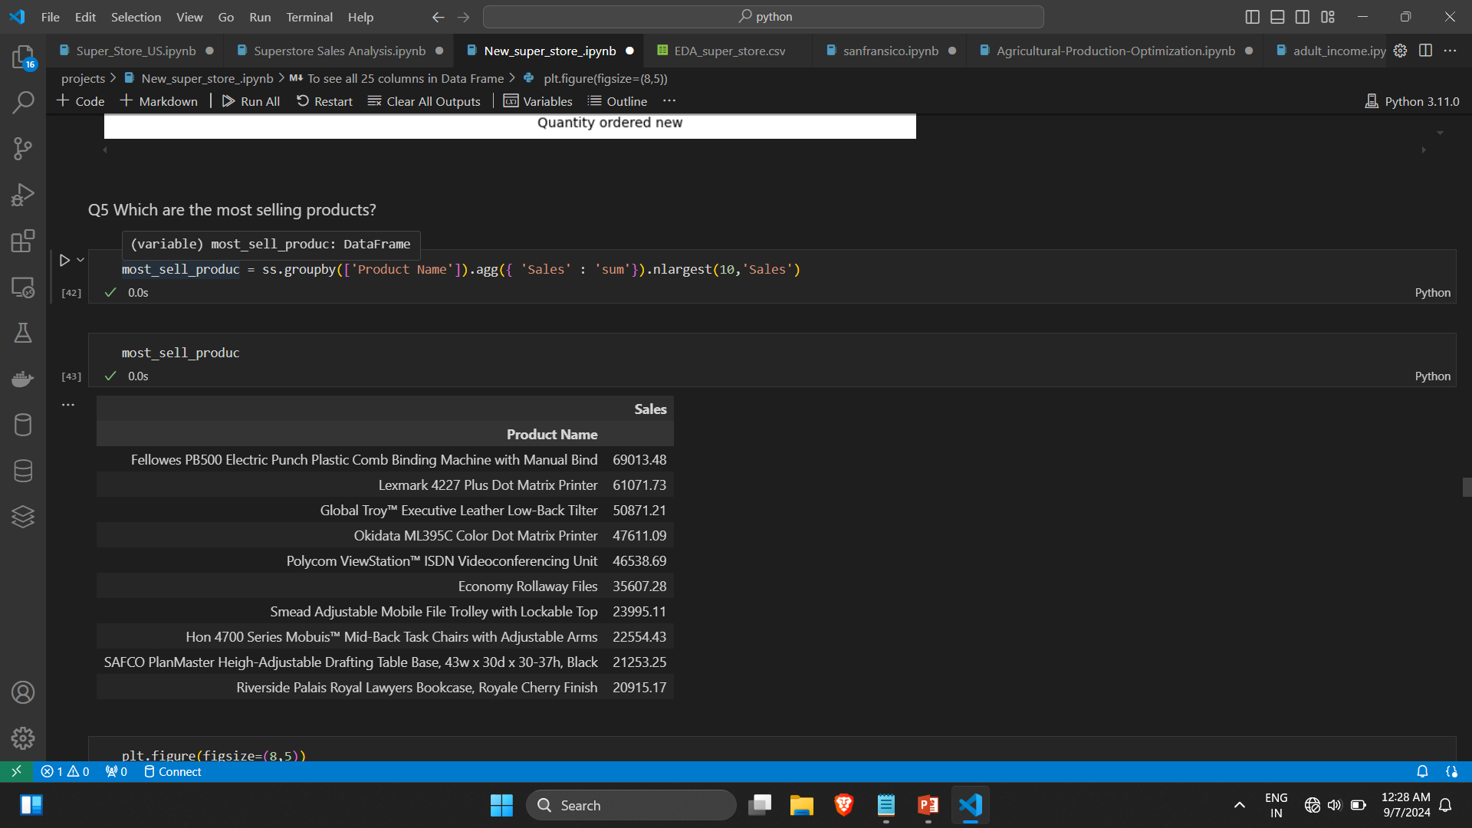
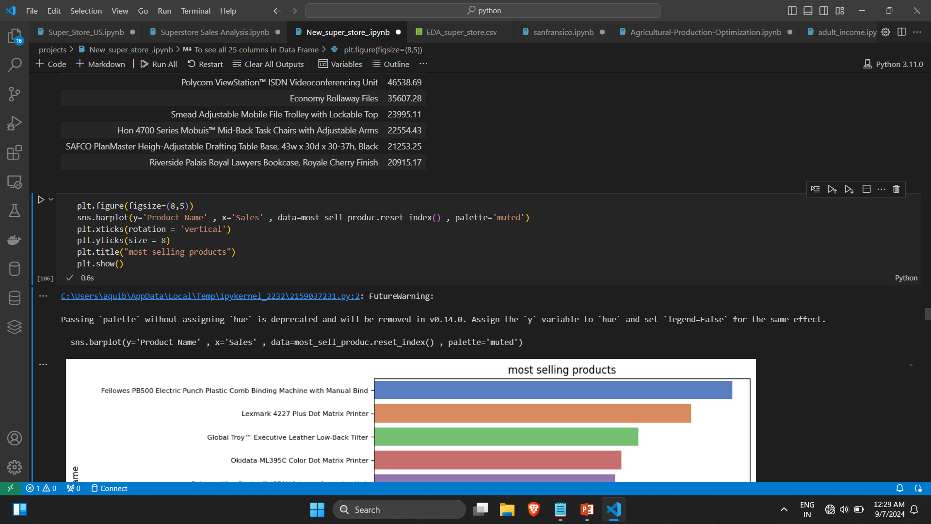
Q 5 Most Selling Products: Analyzed which individual products are sold the most.

Slide 25
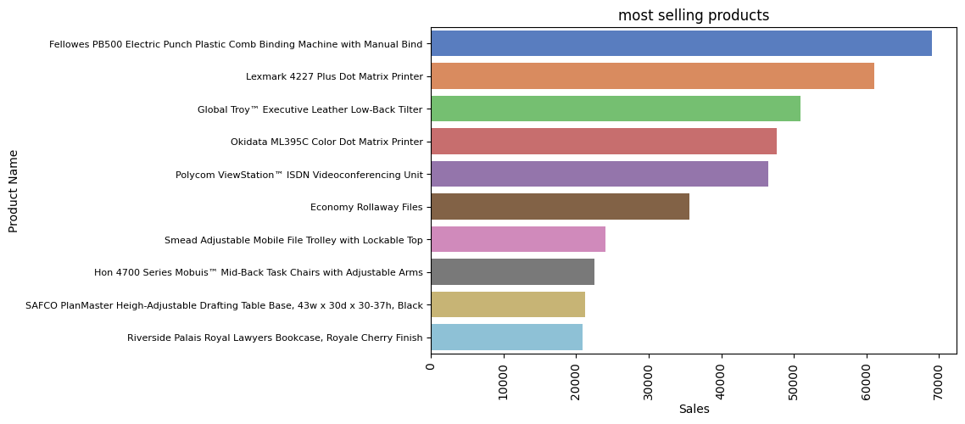

Slide 26
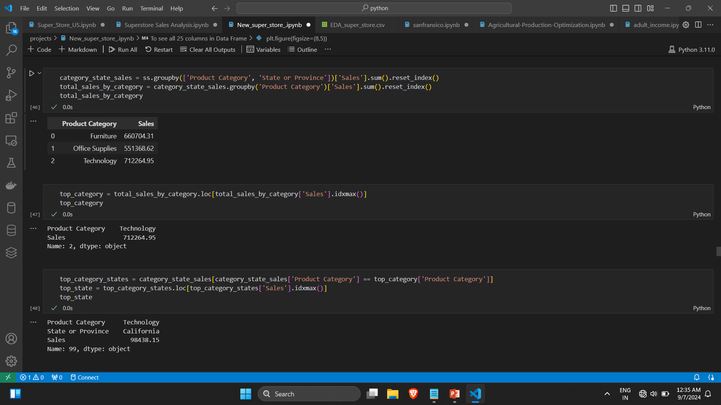
Q 6 Category Sales by State: Explored which categories sell the most in each state

Slide 27
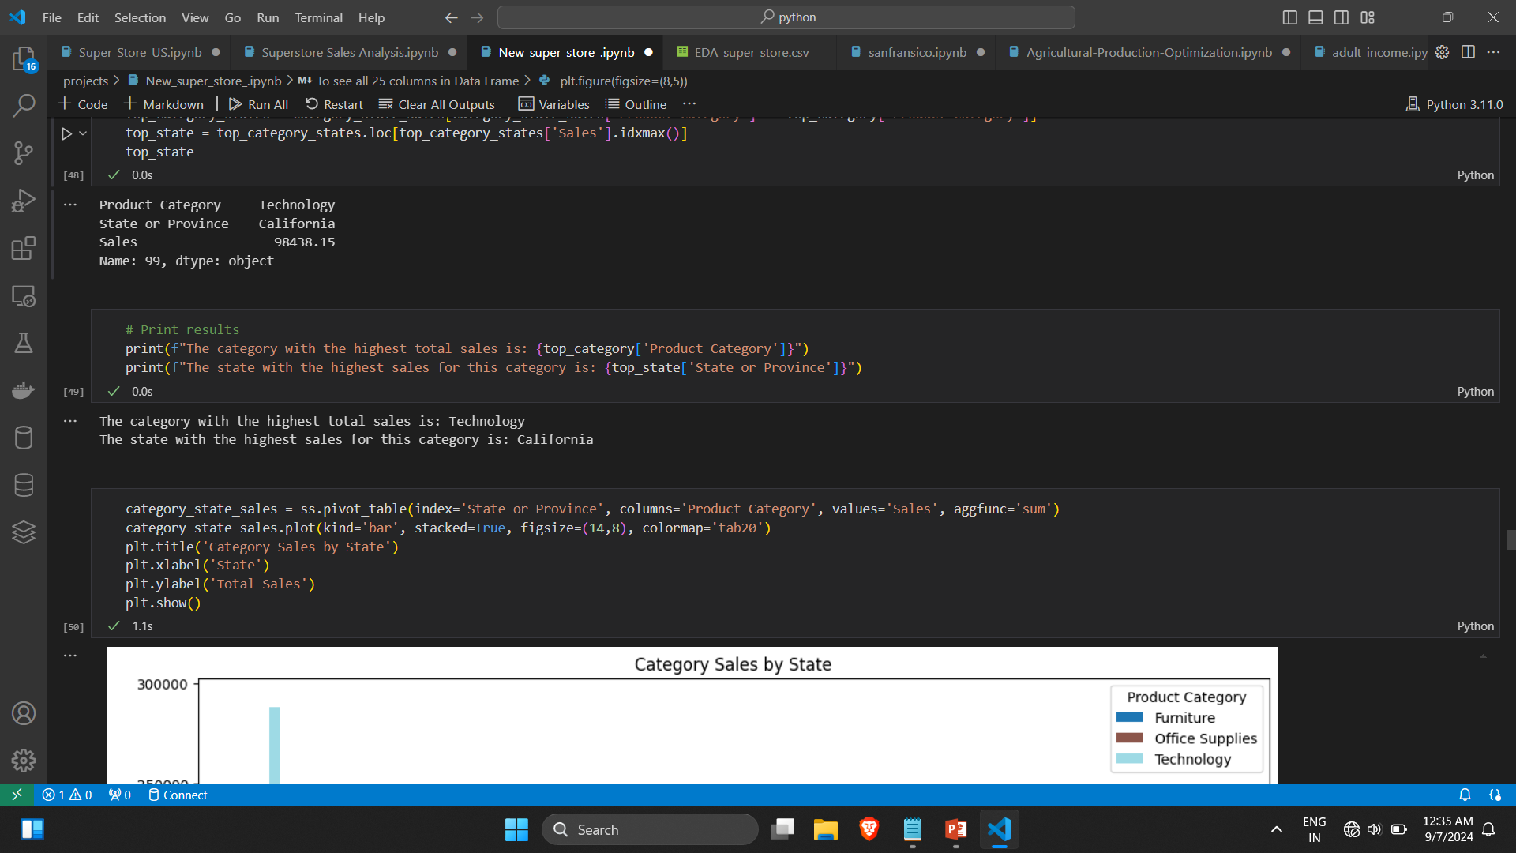

Slide 28
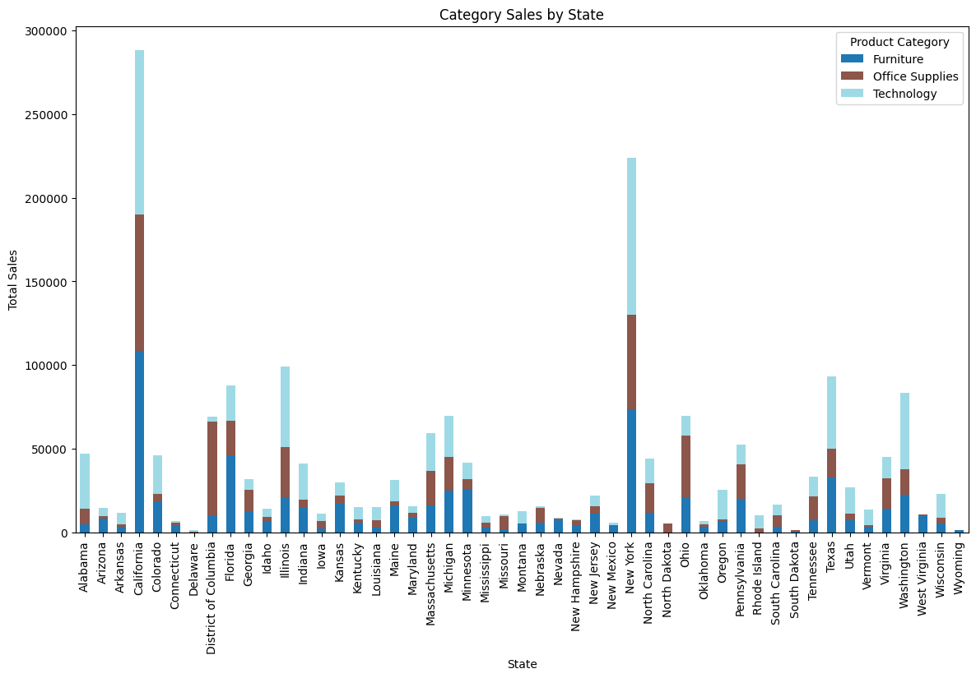

Slide 29
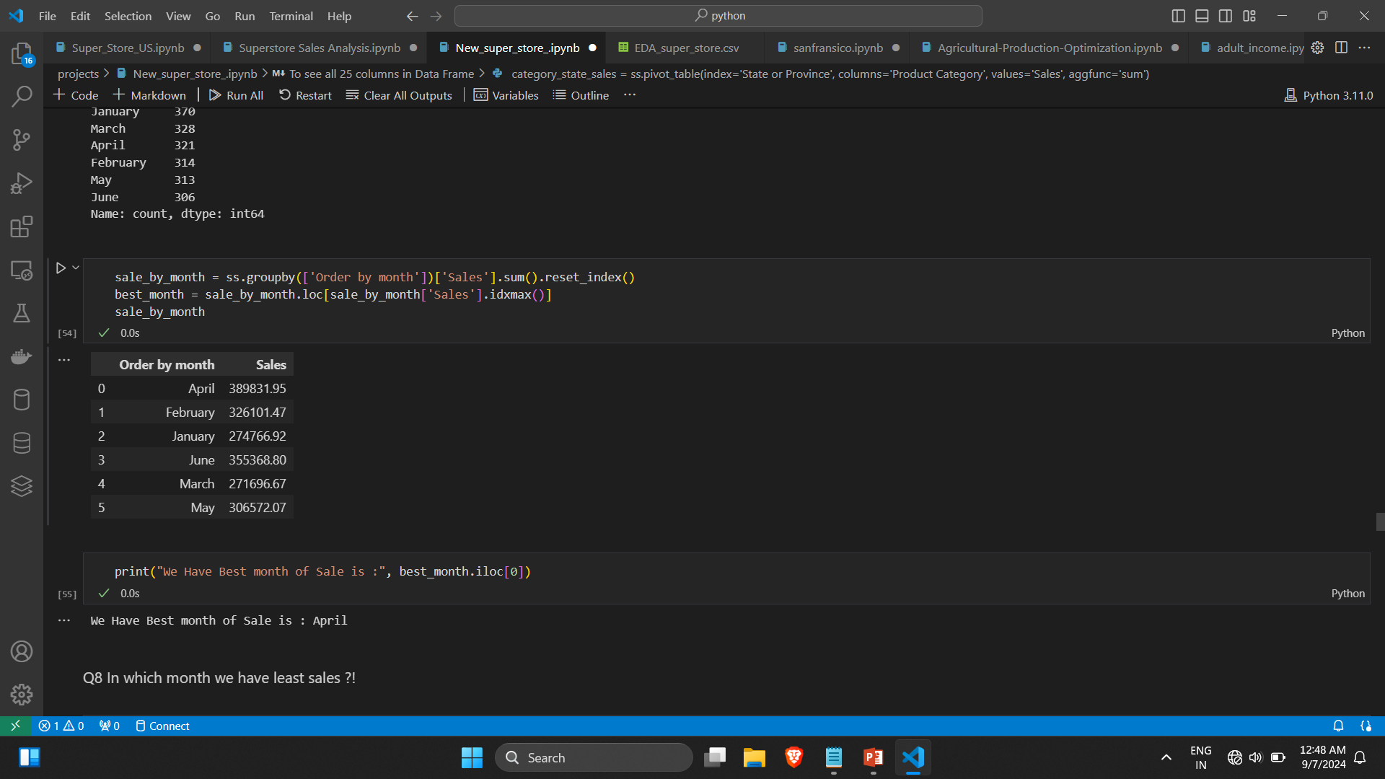
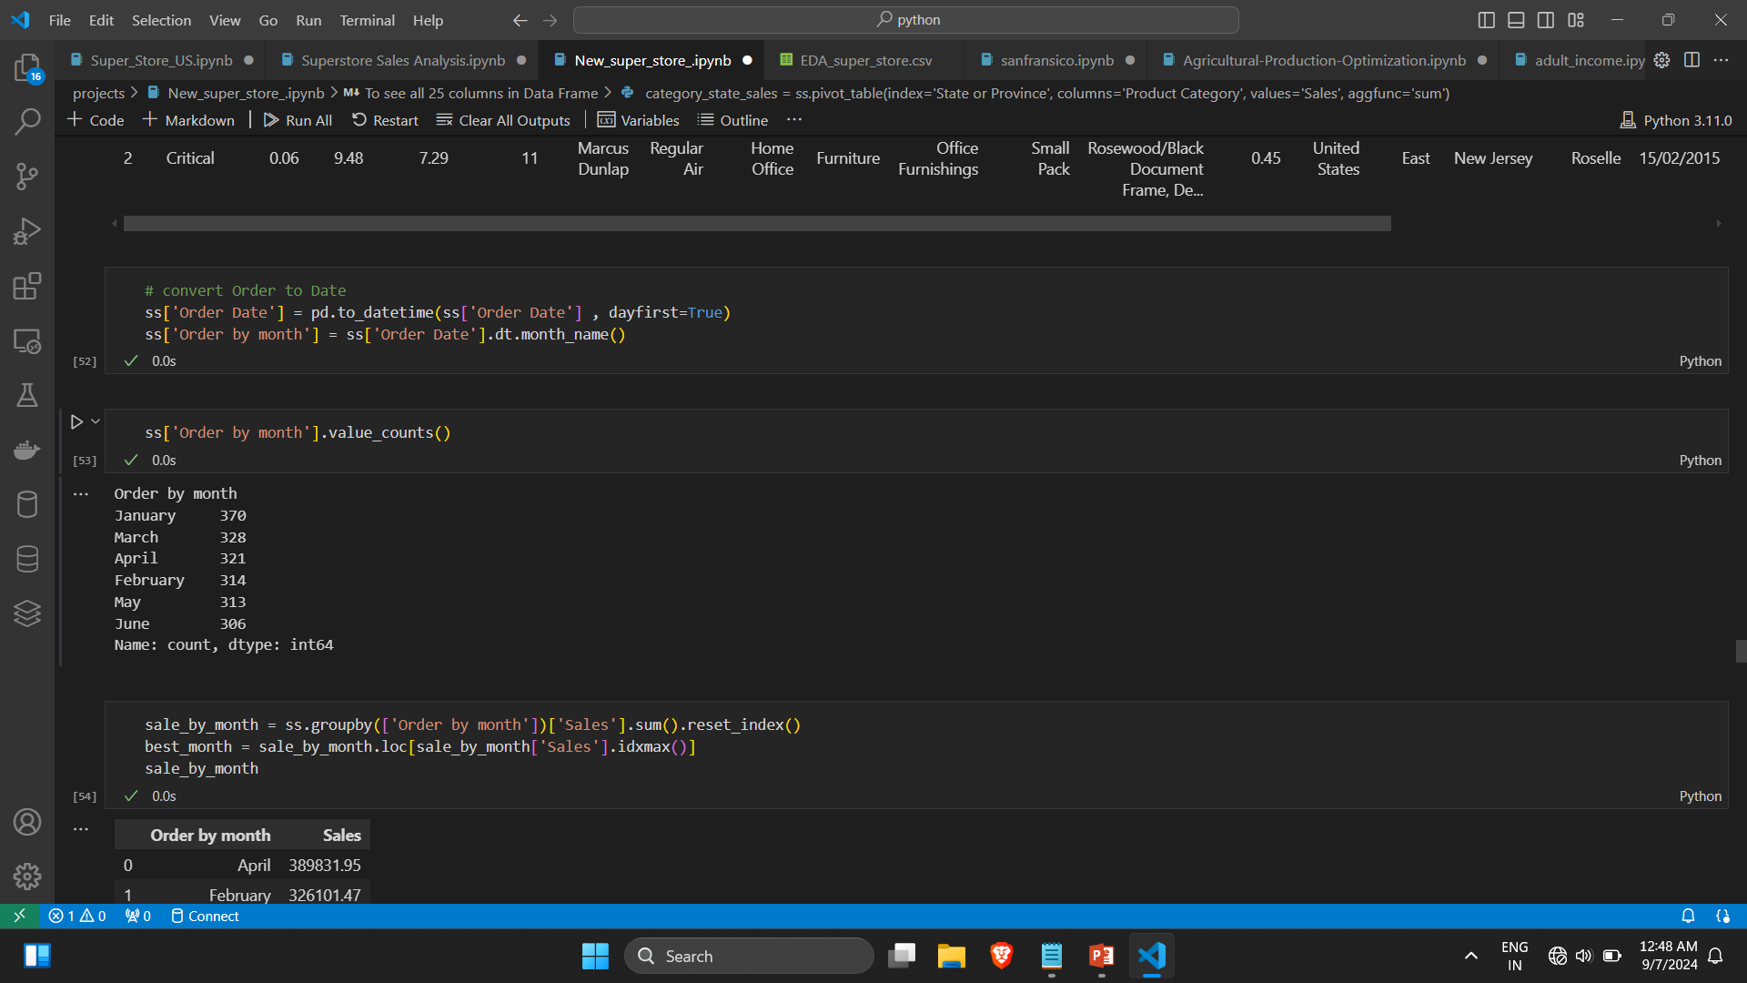
Q 7 Best Sales Month: Identified the month with the highest sales across the dataset.

Slide 30
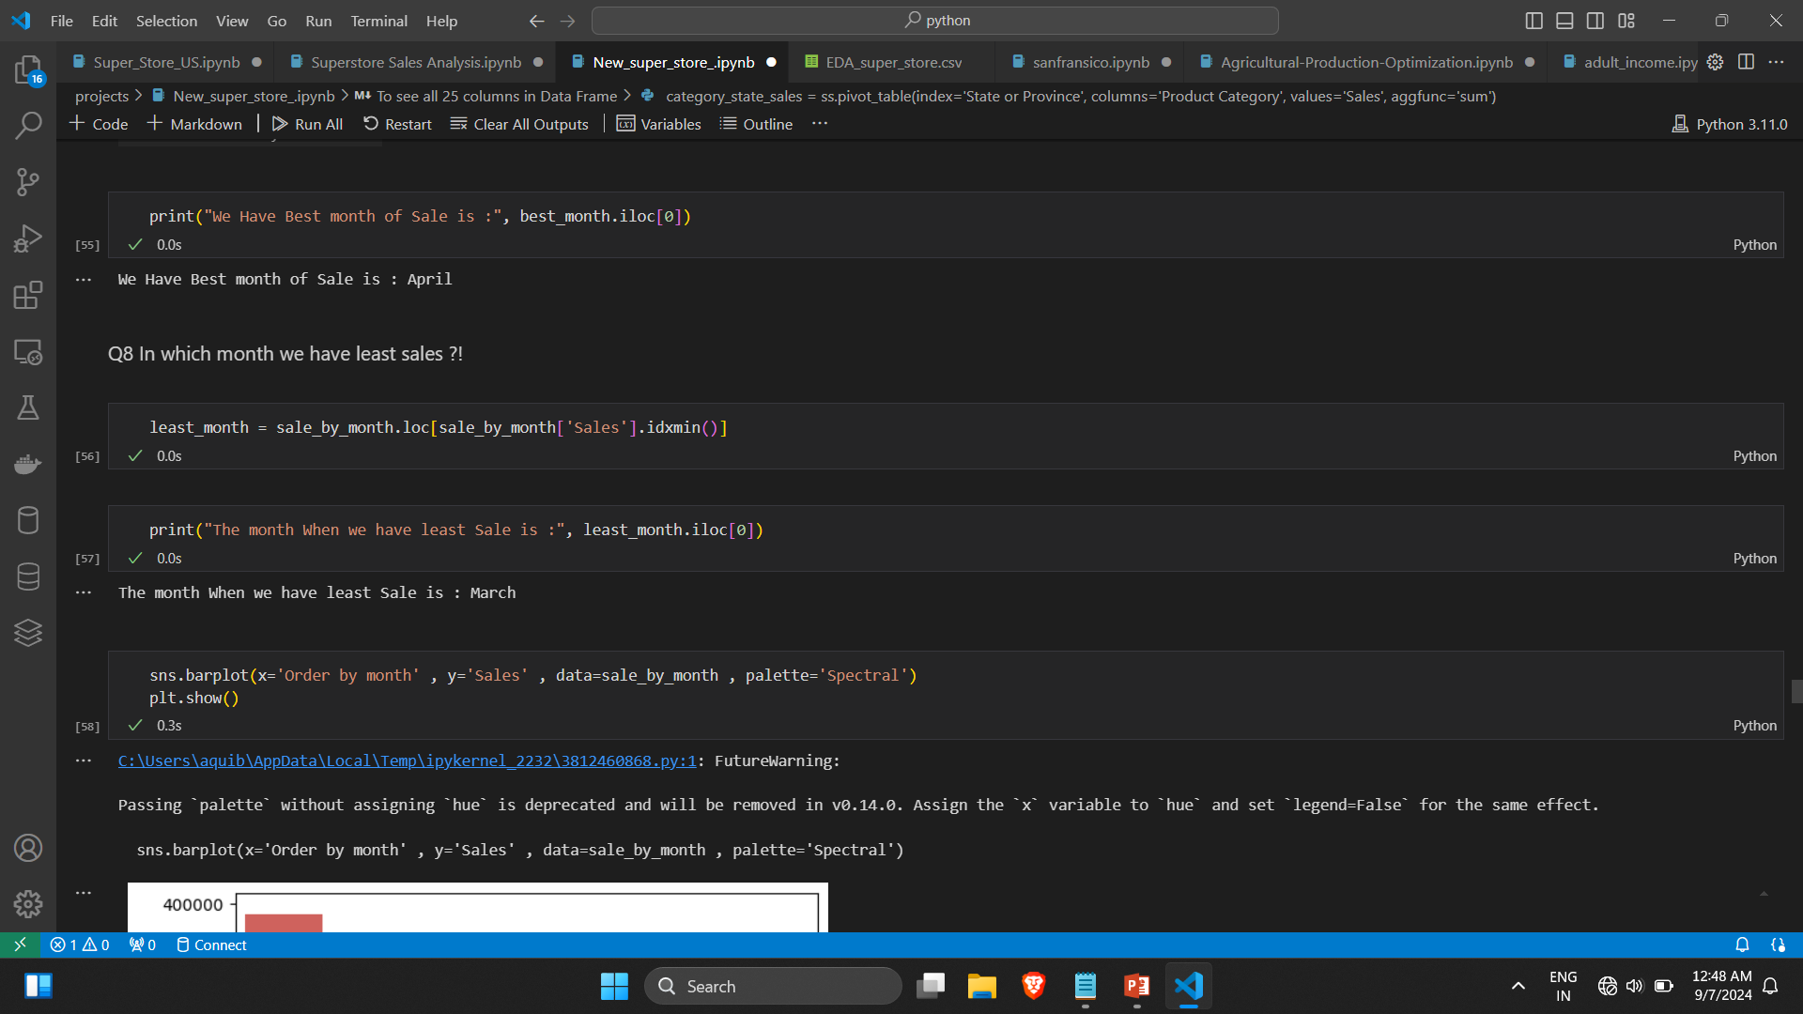
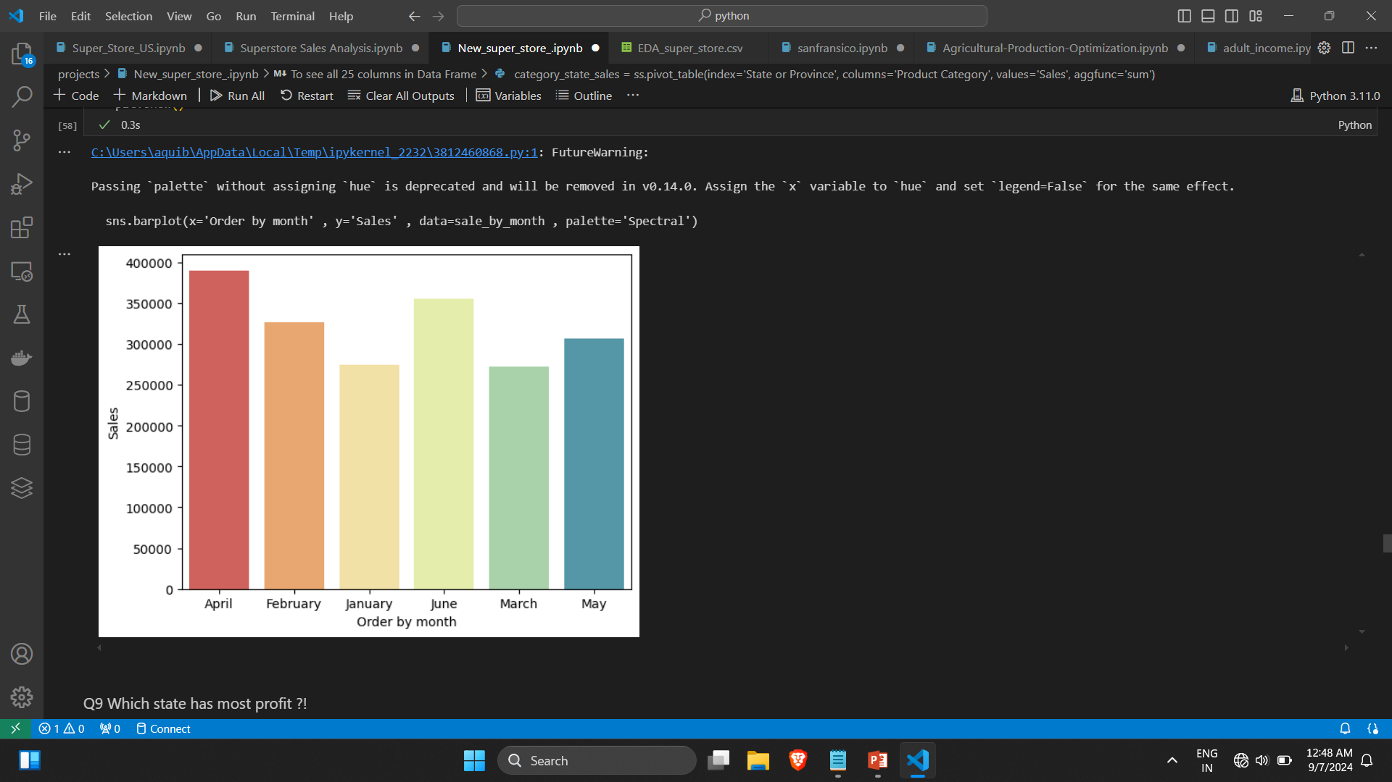
Q 8 Least Sales Month: Determined the month with the lowest sales

Slide 31
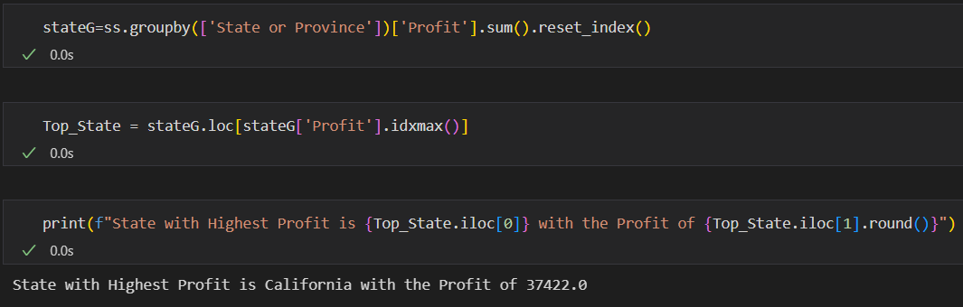
Q 9 State with Most Profit: Analyzed which state generated the highest profit

Slide 32
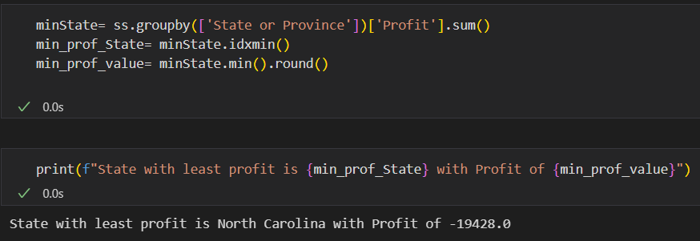
Q 10 State with Least Profit: Identified the state with the lowest profit.

Slide 33
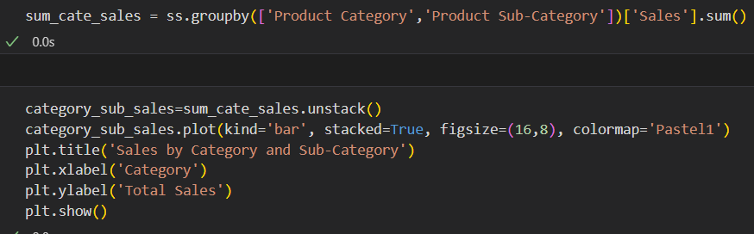
Q11 Sales Values by Category and Sub-Category: Calculated total sales values for each category and sub-category.

Slide 34
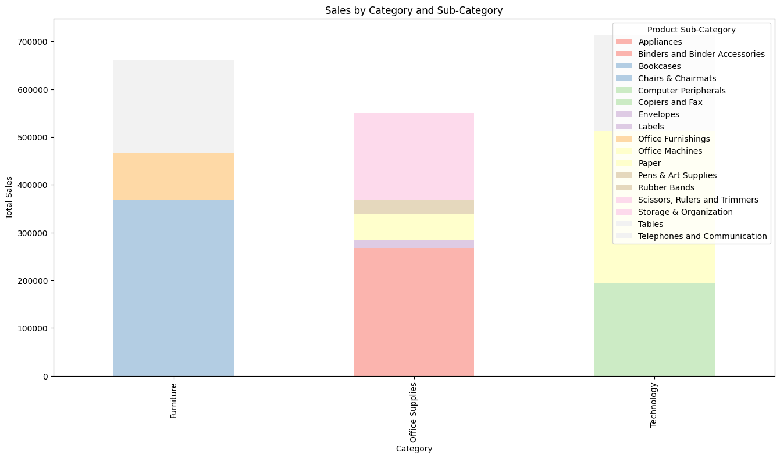

Slide 35
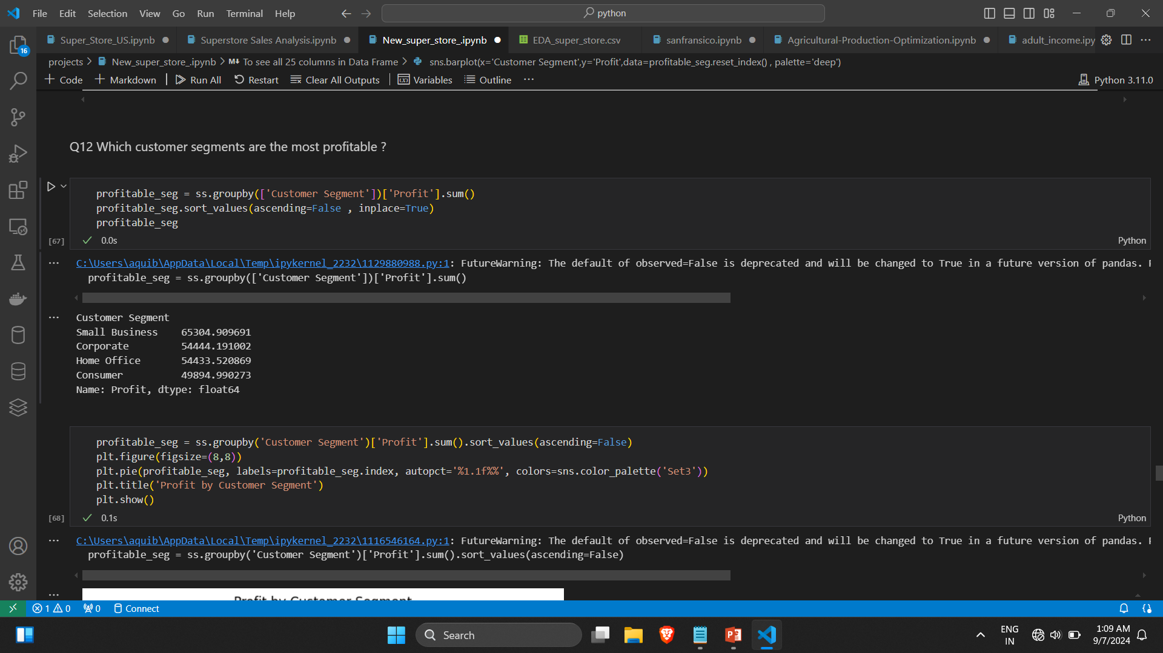
Q 12 Most Profitable Customer Segments: Analyzed which customer segments are the most profitable.

Slide 36
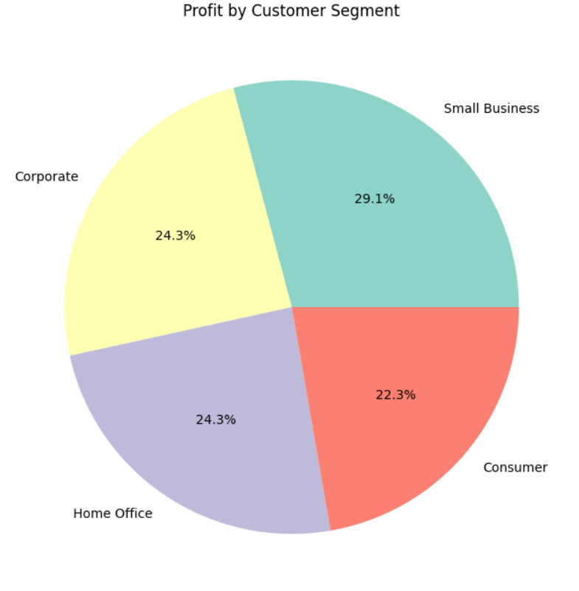

Slide 37
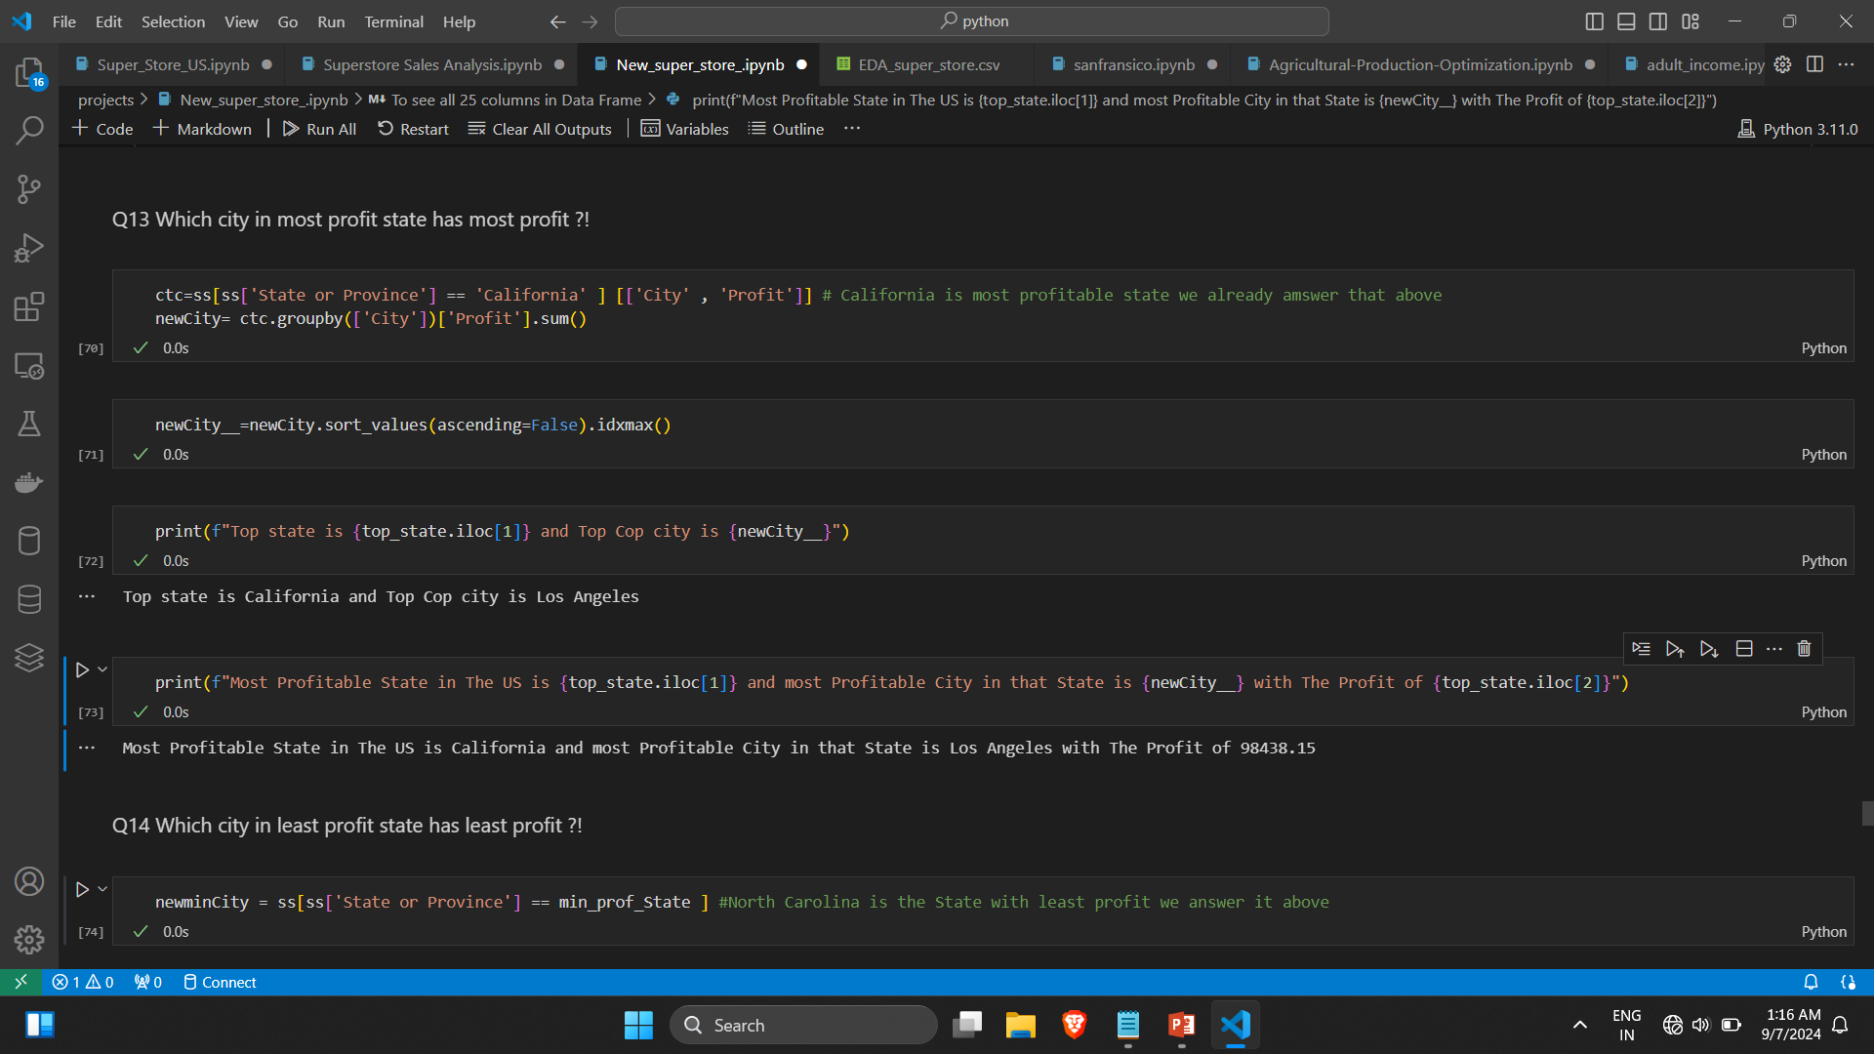
Q 13 Explored which city within the most profitable state generated the highest profit.

Slide 38
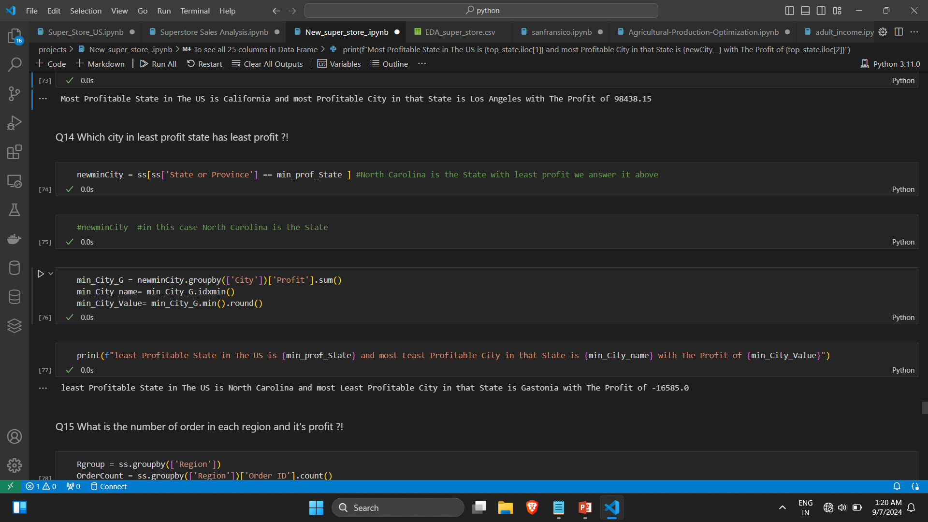
Q 14 Least Profitable City in the Least Profitable State: Identified the least profitable city in the least profitable state.

Slide 39
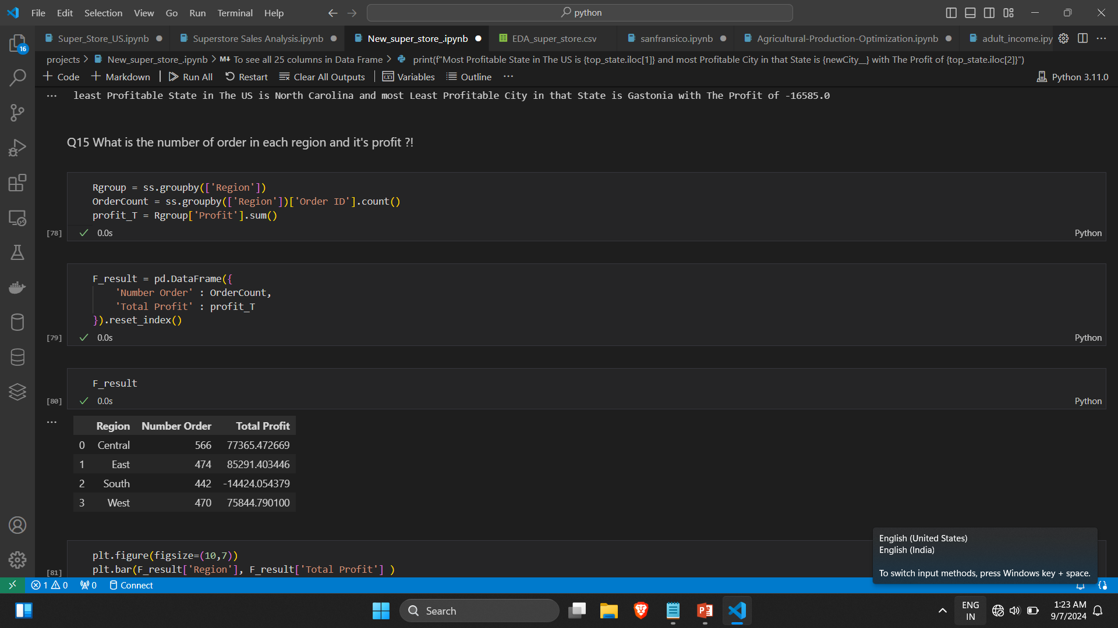
Q 15 Order Count and Profit by Region: Analyzed the number of orders and profit in each region.

Slide 40
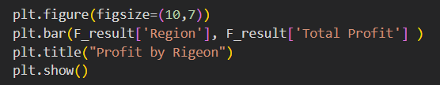
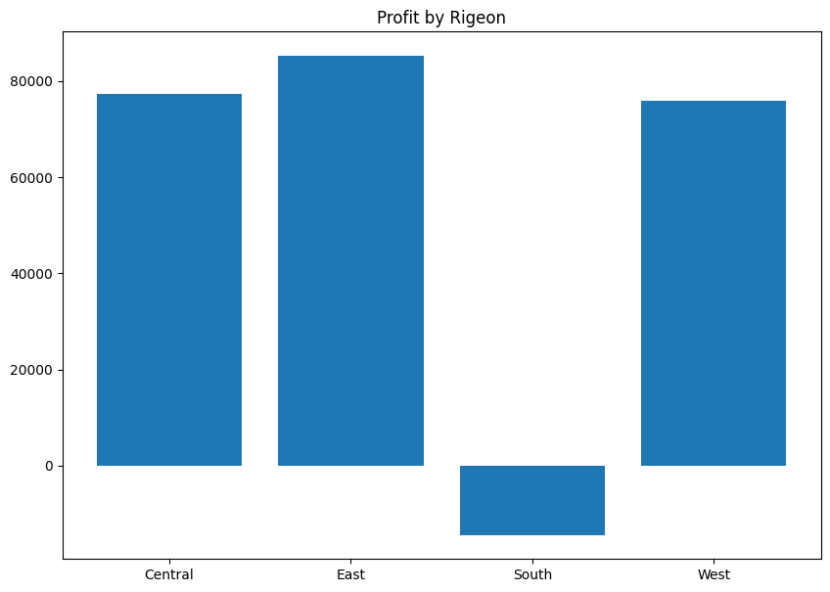

Slide 41
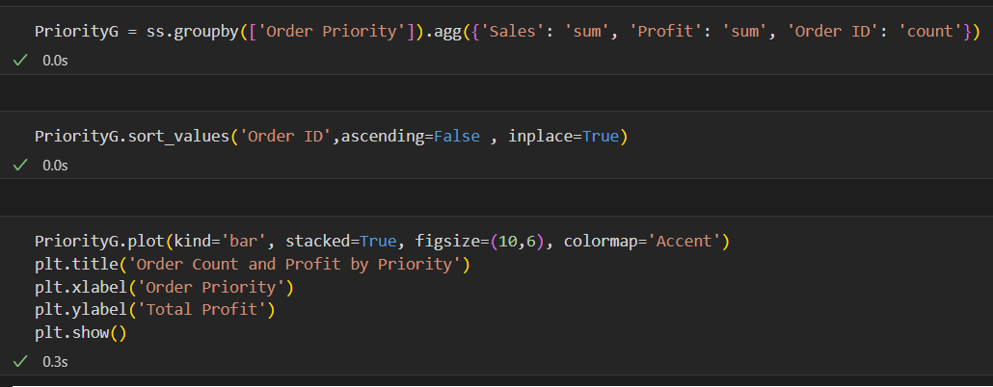
Q 16 Order Count and Profit by Priority: Explored how order priority affects the number of orders and profitability.

Slide 42
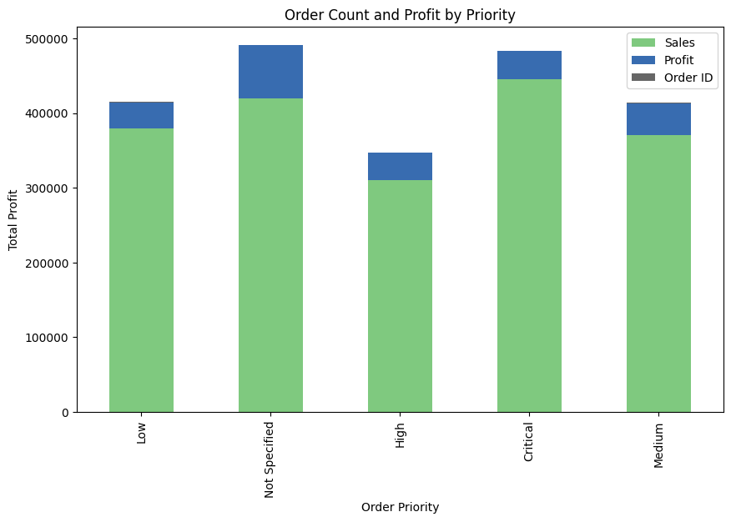

Slide 43
END

